Slide 1
POSITIONS IN THE RESTAURANT
MEETING 10

Slide 2
Organizational Structure
Organizational structure in the restaurant determines the role and duties of the restaurant's positions. The structure helps build the restaurant successfully and thereby, has specific job descriptions. Therefore, the structure must show a clear chain of command.
The type and the size of the restaurant usually determines the ultimate structure. Certain positions may take more than one positions because they have more excellent skills and the skills can be used to advantage the success of restaurant.

Slide 3
Sample 1
Restaurant Manager/Owner
Accountant
Executive Chef
Assistant Restaurant Manager
Cooks
Head Waiter
Dishwasher
Assistant Cooks
Waiter/Waitress
Bus boy/girl
Bus boy/girl

Slide 4
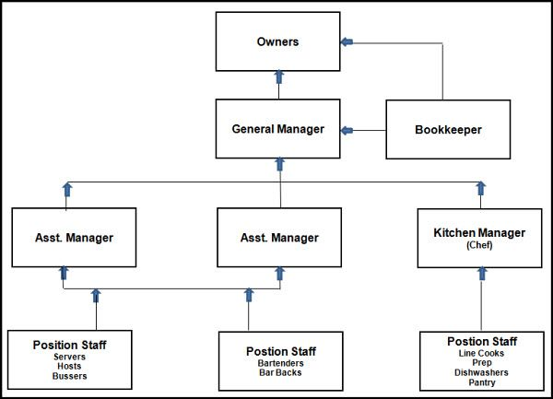
Sample 2

Slide 5
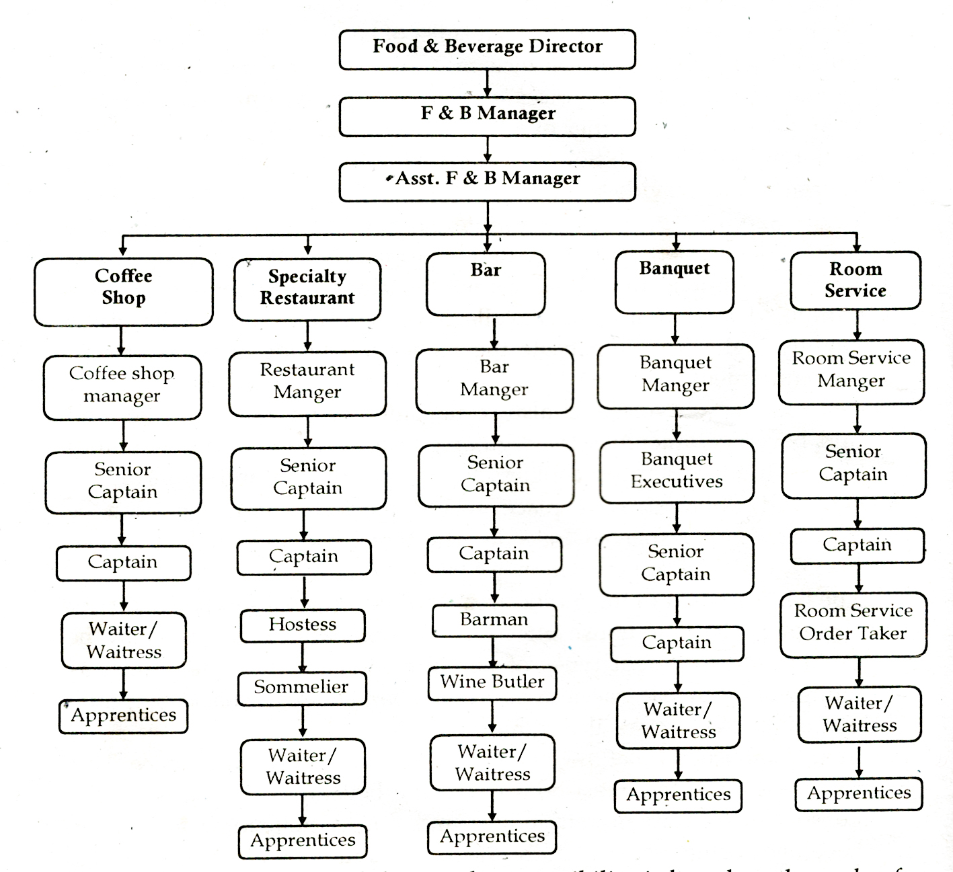
Sample 3

Slide 6
In short,
There are certain and specific positions which are usually and ultimately employed to help build the success of the restaurant. They are:
General Manager/Owner
Assistant Manager
Kitchen Manager
Food & Beverage Manager
Dishwasher
Drive-Thru Operator
Cashier
Barista
Bartender
Sommelier
Host/Hostess/Maître D’/Head Waiter
Server/waiter/waitress
Runner
Busser

Slide 7
In the restaurant
The positions are:
Host/Hostess/Maître D’/Head Waiter
Waiter/Waitress/Server
Runner
Busser
Chef
Barista/Bartender

Slide 8
Specifically, in the kitchen
The positions are:
Executive Chef
Sous Chef
Line Cook
Short Order Cook
Prep Cook
Pastry Chef
Chef Garde Manger

