Slide 1
More Phrases Used in the Restaurant
MEETING 12

Slide 2
Restaurant activities
Booking a seat
Asking about the menu
Ordering a menu
Dealing with problems/complaints
Getting the bill/check/cheque

Slide 3
Booking a seat
Guest:
"I booked a table for two tonight. It's under the name of Hasan.”
"A table for two please.“
WAITER
"Of course. Please come this way."
"Your table isn't quite ready yet.“
"Would you like to wait in the lobby?“
"We're fully booked at the moment. Could you come back a bit later?"

Slide 4
Asking about the menu
GUEST:
"What do you recommend?“
"What is this menu exactly?“
"Is this served with salad?“
"Does this have any seafood in it?“
WAITER:
I recommend you try one of the specials.
The trout. It comes with potatoes and fresh vegetables. It is very good.
This is their standard menu and these are the specials.
Yes, you could try the lamb with the salad in it. It is very nice.

Slide 5
Ordering a menu
WAITER:
"Are you ready to order?“
"Can I take your order?“
"Anything to drink?“
"Would you like chips with that?“
GUEST:
Yes, I’ll have a today's special please.
I’ll take a portion of potatoes, please.
Yes, two glasses of warm orange juice, please.
No, thanks. I’ll have the plain one.

Slide 6
Dealing with problems/complaints
GUEST:
"Excuse me, but I didn't order this.“
"I'm sorry, but this is cold.“
"Can I change my order please?“
“Excuse me, but this isn't what I ordered.”
WAITER:
"I'm so sorry about that“
"Let me take it back for you.“
"Let me change it for you.“
“Oh, I'm so sorry. I'll change it for you straightaway.”

Slide 7
Getting the bill/check/cheque
GUEST:
"Can we have the bill please?“
"Could we get the bill?“
"Could we pay please?“
“I am ready for my bill, please.”
WAITER:
”yes, I will go and get it for you"

Slide 8
Restaurant activities
Booking a seat
Asking about the menu
Ordering a menu
Dealing with problems/complaints
Getting the bill/check/cheque

Slide 9
Practice 1: What is your response?
Guest: I'd like to make a reservation for next week with 18 people. Do you have any vacancies?
Head Waiter: ….(group 1)
Guest: I would like a table for two. Please.
Head Waiter: …. (group 2)
Guest: I have made a table reservation. Can I ask for a menu list?
Waiter: …. (group 3)
Waiter: …. (group 4)
Guest: I would like to have spring rolls and chicken steak with mushroom sauce.

Slide 10
Practice 1: What is your response?
Guest: Can you bring me the ketchup, please?
Waiter: …. (group 5)
Head Waiter: Have you booked a table?
Guest: …. (group 6)
Waiter: What would you like to start with?
Guest: …. (group 7)
Waiter: Sorry, the hamburgers are off.
Guest: …. (group 8)

Slide 11
Practice 1: What is your response?
Guest: Can I see my order on the bill before I pay for it?
Waiter: …. (group 9)
Guest: …. (group 2)
Waiter: Of course. I’ll just go and get the bill for you, Sir.
Guest: Could you double check my bill?
Waiter: …. (group 1)

Slide 12
Practice 1: What is your response?
Guest: Sorry, this is not the drink I ordered.
Waiter: ….(group 3)
Guest: Well Sir, this table doesn't match my order. I ordered a table with shades of birthday celebration.
Host: ….(group 4)
Host: Sorry, Miss, we don't have a steak menu in our restaurant, but we do have a menu that is better than steak. Don't you want to try it?
Guest: ….(group 5)

Slide 13
Practice 1: What is your response?
Guest: You are the Manager right? How will you be responsible for the cleanliness of the food in your restaurant?
Manager: ….(group 6)
Guest: I feel uncomfortable with your employee service. How will you be responsible?
Manager: ….(group 7)
Guest: ….(group 8)
Host: we apologize in advance, miss. There may be a misunderstanding. I will fix it as soon as possible.

Slide 14
Practice 1: What is your response?
Host: ….(group 9)
Guest: Yes, I think there is something wrong about the menu. I Ordered kimchi fried rice instead of chicken fried rice.

Slide 15
Some terms used in the restaurant
The dining room and bar where the customers are served and wait staff, bartenders, bussers and dining room managers primarily work.
(Front of the house--FOH)
The back end of the restaurant: the kitchen and storage areas.
(Back of the house--BOH)

Slide 16
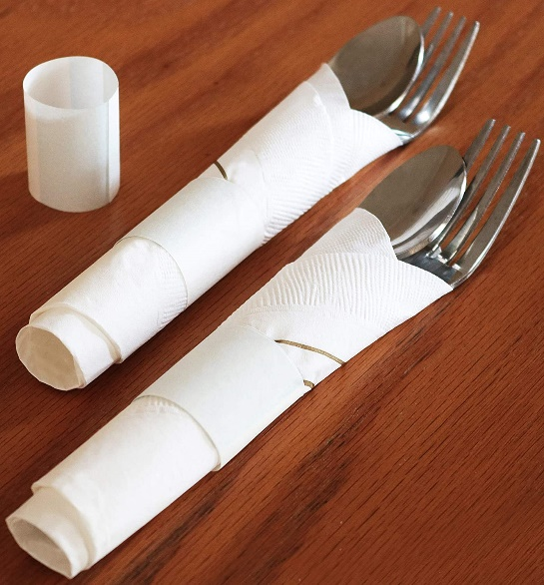
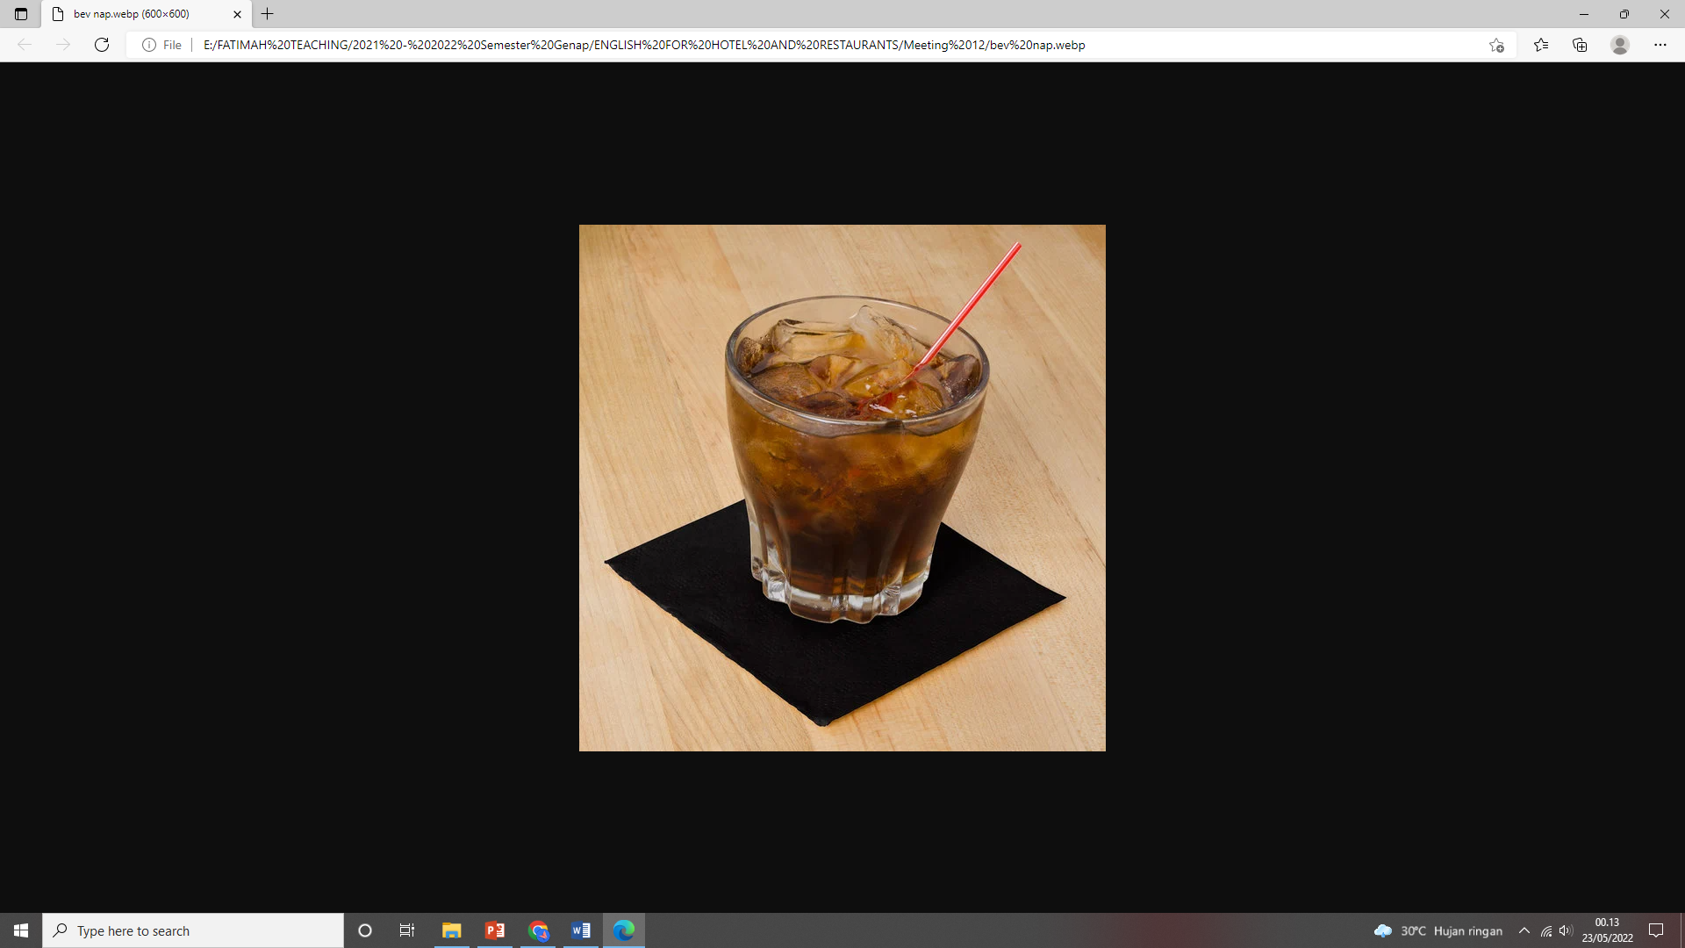
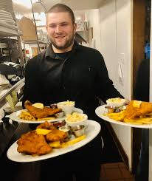
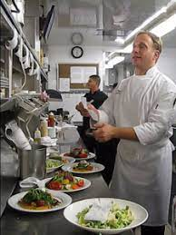
Bev nap
              Rollup
Expeditor/Expo

Slide 17
Very overcook or extra extra well done. For example: “Table 5 wants his burger very overcooked”
(Cremated/killed)
Two shifts in a row. For example: “I’m exhausted, I just pulled two shifts in a row.”
(Double)
Taking a guest’s bill to their table for payment.
(Drop the Cheque)
The moment at which the kitchen begins to prepare a guest’s food or the moment a server delivers an order to the customers
(Drop Food/Order ) for example: “I just dropped the drinks on table 4.”
Food that is nearly or totally not servable
(Dying/Dead Plate) for example: “My shrimps dying in the window, because I don’t have vegetables to go with it!”

Slide 18
The service that people want everything included for very little money.
(Early Bird) For example: “The $12.95 all you can eat buffet”.
A cheap meal that is generally available for a limited amount of time when the restaurant opens for service.
(Early Bird Special)
Employee who does not show up and does not call or a Reservation that does not show up and does not call.
(No Call/No Show)
Something needed quickly
(on a Rail or On the Fly) for example: “I need table 2’s salads on a rail!” Or, “Give me a well done tender on the fly.”

Slide 19
What’s your quick reply?
Guest: Now this is what I call quality service.
Host: ….
Guest: ….
Waiter : Okay Sir, let me repeat your order. You ordered a chicken steak with mushroom sauce and a glass of avocado juice.

Slide 20
What’s your quick reply?
Guest: Can I change my order?
Waiter: ….
Guest: What’s the specialty here?
Waiter: ….
Guest: Will the steak be served with the potatoes?
Waiter: ….

Slide 21
What’s your quick reply?
Guest: ….
Host: I'm really sorry, Miss. Today, the visitors are really booming. So, we were overwhelmed. We apologize for the inconvenience.
Guest: I want 1 cup of Moccachino, 2 cups of green tea and 3 pieces of red velvet with a sprinkling of cheese on top.
Waiter: ….
Guest: How about the taste of Hokkian Noodles? I never eat it.
Waiter: ….

Slide 22
What’s your quick reply?
Guest: Can you tell me what is another dish coming with the Salad?
Waiter: ….
Guest: Can you pack my left over?
Waiter: ….
Guest: ….
Waiter: We have Jalangkote for appetizer, Rendang with Burasa for main course and Pisang Ijo for dessert.

Slide 23
THANK YOU

