Slide 1
HOW TO APPLY
ENGLISH SPEAKING PRACTICE APPLICATION

Slide 2
DOWNLOAD THE APPLICATION “ENGLISH SPEAKING PRACTICE” AT PLAYSTORE OR APPSTORE

Slide 3
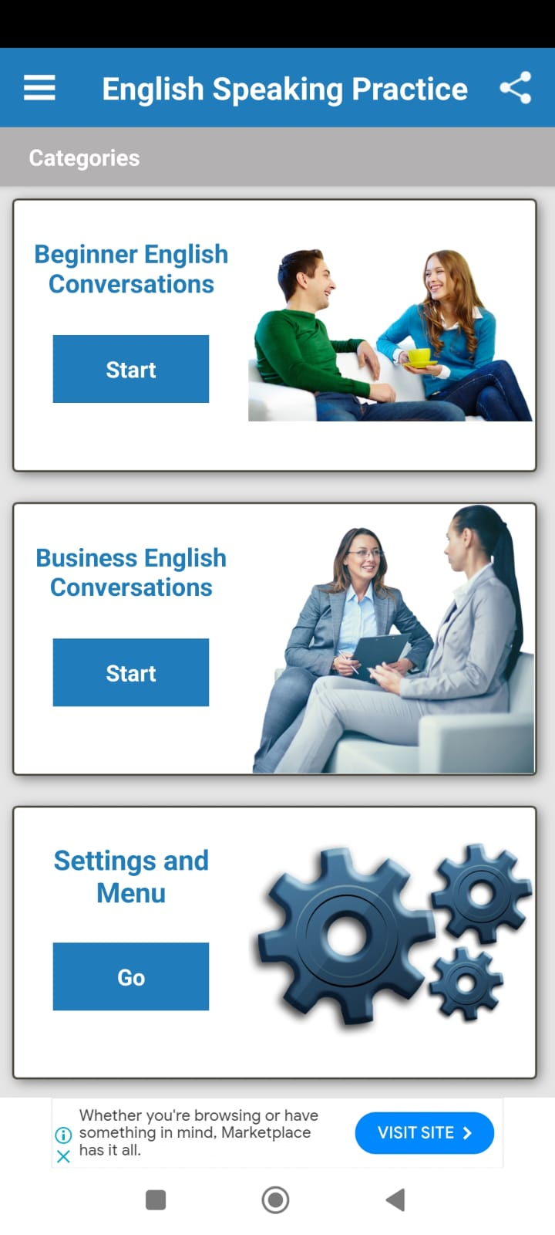
IF YOU HAVE DOWNLOADED IT, PLEASE OPEN THE APP AND THERE ARE TWO DIFFERENT LEVEL OF SPEAKING PRACTICE 1. CHOOSE BEGINNER “BEGINNER ENGLISH CONVERSATION” IF YOU ARE BEGINNER LEVEL 2. CHOOSE BUSINESS ENGLISH CONVERSATION IF YOU ARE UPPER AND INTERMEDIATE LEVEL

Slide 4
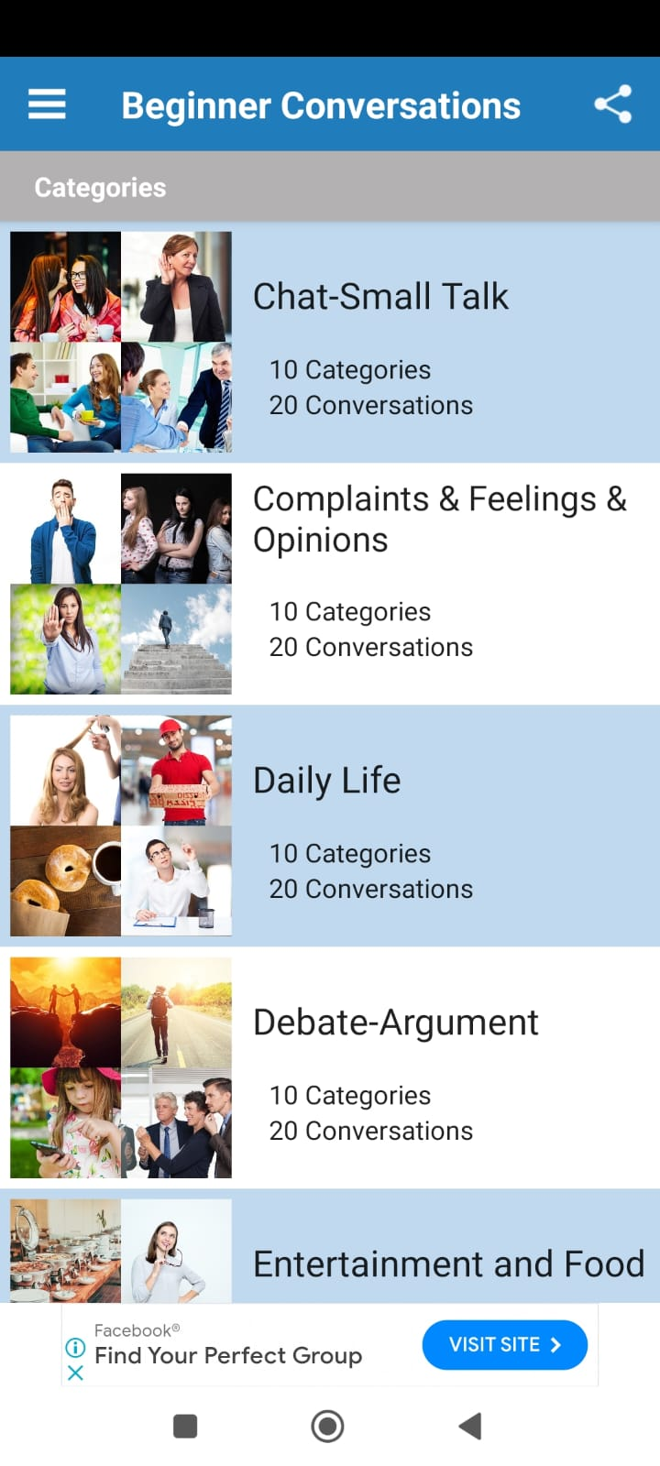
THEN IF YOU HAVE CHOSEN IT, PLEASE CLICK START AND THEN PICK ONE OF TOPIC CONVERSATION

Slide 5
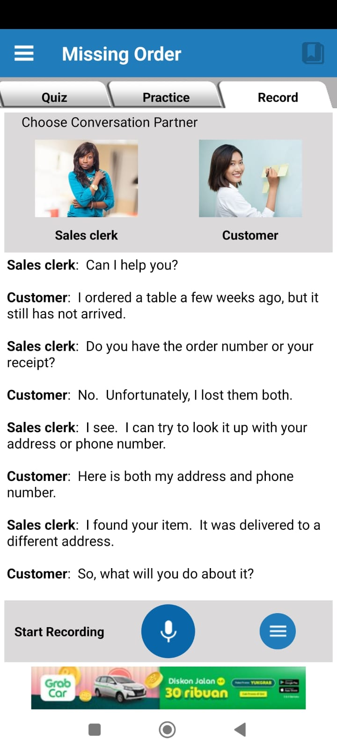
YOU WILL PRACTICE WITH ANONYMOUS SPEAKER, YOU ALLOW TO DO THE TASK AND YOU ARE ABLE TO RECORD YOUR VOICE WHILE YOU PRACTICE THE CONVERSATION

