Slide 1
Telekomunikasi
SOFTWARE DEFINED RADIO

Slide 2
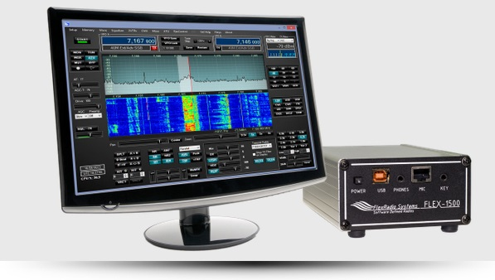
SOFTWARE DEFINED RADIOS

Slide 3
OUTLINE
BACKGROUND
SDR BASIC REQUIREMENTS
SOFTWARE DEFINED RADIOS VERSUS TRADITIONAL RADIOS
COMMON APPLICATIONS OF SOFTWARE DEFINED RADIOS
SPACE BASED SDR APPLICATIONS
DESIGN PROCEDURES OF SOFTWARE DEFINED RADIOS
TRENDS
CONCLUSION
IMAGE SOURCES

Slide 4
Background
SDR is a programmable transceiver with the capability of operating various wireless communications protocols without the need to change or update the hardware
SDR is typically a radio in which some or all of the physical layer functions are software defined“
SDR is a radio communication system where components that have been typically implemented in hardware (e.g mixers, filters, amplifiers, modulators/demodulators, detectors, etc.) are instead implemented by means of a software on a personal computer or embedded system.
Notes:
A device that can both transmit and receive communications, in particular a combined radio transmitter and receiver.
Progress in SDR has led to escalation in protocol development and a wide spectrum of applications
SDR Designers intend to simplify the use of communication protocols
It also facilitates experimentation with prototypes on deployed networks
Progress in SDR has led to more emphasis on programmability, flexibility, portability, and energy efficiency, in cellular, Wi-Fi, and M2M communication
Advances in wireless technologies have altered consumers communication habits. Wireless technologies are an essential part of users daily lives, and its effect will become even larger in the future.
In a technical report, the World Wireless Research Forum (WWRF) has predicted that 7 trillion wireless devices for 7 billion people will be deployed by 2020 [1].

Slide 5
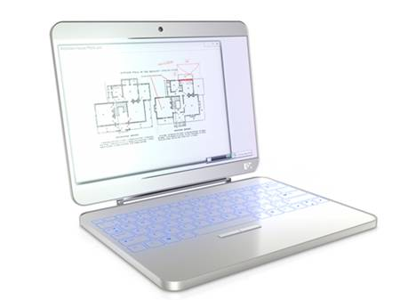
Background
The driving factors for the high demand of SDR include:
Network interoperability
Readiness to adapt to future updates and new protocols
Lower hardware and development costs
GPS, Cell Phone

Slide 6
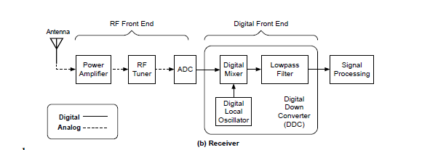
BACKGROUND
Block Diagram
Transmitter
Antenna
RF Front End
Digital to analog converter
Digital Front End
Signal Processing
Receiver
Antenna
RF Front End
Analog to Digital Converter
Digital Front End
Signal Processing

Slide 7
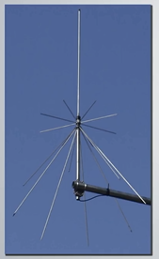
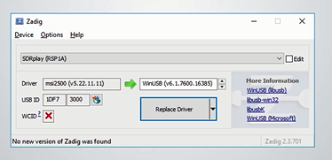
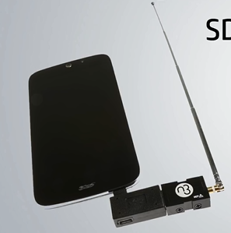
SDR BASIC requirements
SDR Receiver
Antenna(s)
Computer Running SDR Software
RTL-SDR Drivers

Slide 8
traditional radios vs Sdr
Traditional Radios | Software Defined Radios
Traditional hardware based radio devices limit cross-functionality and can only be modified through physical intervention. This results in higher production costs and minimal flexibility in supporting multiple waveform standards. | By contrast, software defined radio technology provides an efficient and comparatively inexpensive solution to this problem, allowing multimode, multi-band and/or multi-functional wireless devices that can be enhanced using software upgrades.

Slide 9
traditional radios vs Sdr
BENEFITS OF SDR | LIMITATIONS OF SDR
It is possible to achieve very high levels of performance | Analog to digital converters limit top frequencies that can be used by the digital section
It is possible to reconfigure radios by updating software | For very simple radios the basic platform may be too expensive
Performance can be changed by updating the software(it will not be possible to update hardware dependent attributes though | Development of a software defined radio requires both hardware and software skills.
The same hardware platform can be used for several different radios.

Slide 10
COMMON APPLICATIONS OF SOFTWARE DEFINED RADIOS
The concept of unified platform and the ability to correct errors in real time are the classic applications of SDR. However, studies have identified other significant applications, such as: Dynamic Spectrum Positioning, Opportunity Driven Multiple Access (ODMA), Spectrum Regulation and Cost Reduction (some SDR implementations are more cheaper than its analog counterpart)
A little beyond its traditional applications, the SDR philosophy begins to dawn on high-impact areas within telecommunications

Slide 11
COMMON APPLICATIONS OF SOFTWARE DEFINED RADIOS
Listen to Broadcast Stations (88Mhz – 108Mhz)
Listen to Aircraft (Around 118Mhz AM)
This is the case of Driver Assistance
GPS signals' Reception
HF Propagation Analysis
Interpretation of Cellular Technology Emissions
particularly the OFDM modulation
and the Identification of Radio Frequency Emissions
Receive weather FAX (HF and VHF via Satellite)

Slide 12
Space based sdr applications
In addition to requirements for frequency, bandwidth and regulations found in every communication system, Software Defined Radios (SDR) are highly dependent on the hardware platform used to run the software. In small satellites, the main design drivers are size, mass, cost and power consumption.

Slide 13
Space based sdr applications CONT’D

Slide 14
Space based sdr applications CONT’D
GomSpace SDR
The SDR system is built by combining three standalone components:
GomSpace NanoCom TR- 600 (transceiver),
NanoMind Z-7000 (processor/FPGA-unit)
and the NanoDock SDR [5].
There is shielding added to the components and the size of the system is 22 x 16 x 5 mm. The RF capabilities are provided by the AD9361 transceiver

Slide 15
Space based sdr applications CONT’D
FunCube
FunCube Pro is a very small SDR which uses a Silicon tuner as RF frontend and a PIC24FJ32 GB002 as microprocessor. The transmitter frequency range is from 0.64 MHz-1.1 GHz, whereas from receiving is from 1.27 - 1.7 GHz.
FunCube ProPlus is a similar SDR. It covers from 150 KHz-240 MHz and from 420 MHz to 1.9 GHz and has a maximum bandwidth of 56 MHz.
Both FunCube models where made to support HAM radio satellite missions.

Slide 16
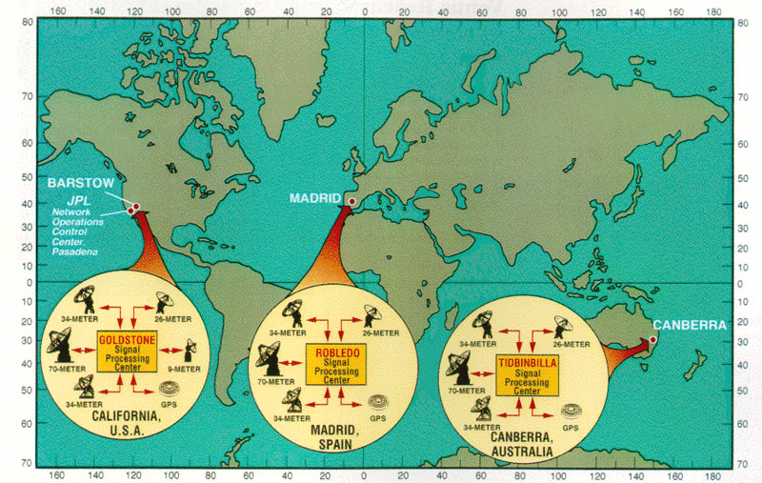
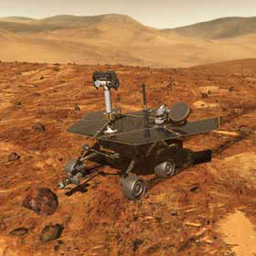
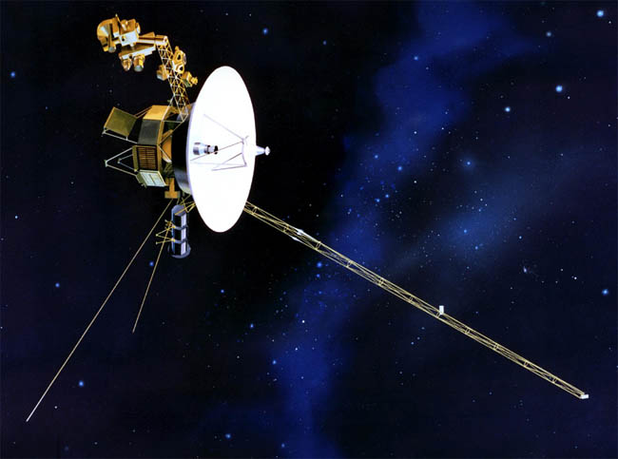
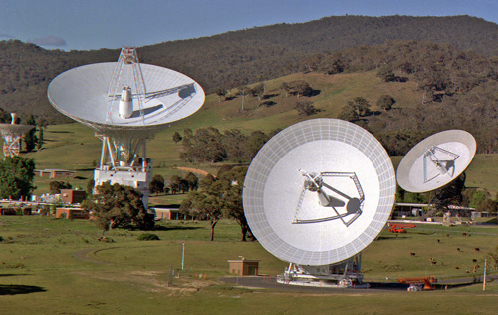
Space based sdr applications CONT’D
Deep Space Communications

Slide 17
DESIGN PROCEDURES OF SOFTWARE DEFINED RADIOS
A. GPP-based
One of the first approaches to realizing SDR platforms is using a General Purpose Processor (GPP), or the commonly known generic computer microprocessors such as x86/64 and ARM architectures. Examples of SDR platforms that utilize GPPs include Sora [18], KUAR [34], and USRP [17].
B. DSP-based
The DSP-based solution can be considered as a special case of GPP-based solutions, but due to its popularity and unique processing features, it deserve a separate discussion. An example of DSP-based SDR is the Atomix platform [19]which utilizes TI TMS320C6670 DSP [55].
Notes:
In this section, we discuss the classification of the various SDR design methodologies of the baseband processing block,
namely GPP, GPU, DSP, FPGA, and co-design based methodologies.
Flexibility and Reconfigurability.
Adaptability.
Computational Power.
Energy Efficiency.
Cost.

Slide 18
DESIGN PROCEDURES OF SOFTWARE DEFINED RADIOS CONT’D
C. FPGA-based
Another approach towards realizing SDRs is to use a programmable hardware such as FPGAs. Example of FPGAbased SDR platforms are Airblue [20], Xilinx Zynq-based implementation of IEEE 802.11ah [73], and [74] that used the same FPGA board to implement a complete communication system with channel coding.
Notes:
In this section, we discuss the classification of the various SDR design methodologies of the baseband processing block,
namely GPP, GPU, DSP, FPGA, and co-design based methodologies.
Flexibility and Reconfigurability.
Adaptability.
Computational Power.
Energy Efficiency.
Cost.

Slide 19
TRends
SDR can act as a key enabling technology for a variety of other reconfigurable radio equipments commonly discussed in the advanced wireless market.
While SDR is not required to implement any of these radio types, SDR technologies can provide these types of radio with the flexibility necessary for them to achieve their full potential, the benefits of which can help to reduce cost and increase system efficiencies.

Slide 20
Trends CONT’D
Adaptive Radio: This is radio in which communications systems have a means of monitoring their own performance and modifying their operating parameters to improve this performance.
Cognitive Radio: This radio learn about their environment (e.g., other users nearby, interference, location, elevation) to optimally configure themselves.
Intelligent Radio: Intelligent radio is cognitive radio that is capable of machine learning.

Slide 21
conclusion
In this presentation, an overview of the various design approaches and hardware platforms adopted for SDR solutions was. This includes GPPs, GPUs, DSPs, FPGAs. Also the basic architectures was explained and analyzed, the presentation further looked into the application, development and emerging trends of Software Defined Radios.

Slide 22
THANK YOU

