Slide 1
ARSITEKTUR KOMPUTER PERTEMUAN 6

Slide 2
Recall: Chapter 4 – Common Memory Parameters
Memory Type | Technology | Size | Access Time
Cache | Semiconductor RAM | 128-512 KB | 10 ns
Main Memory | Semiconductor RAM | 4-128 MB | 50 ns
Magnetic Disk | Hard Disk | Gigabyte | 10 ms,10 MB/sec
Optical Disk | CD-ROM | Gigabyte | 300 ms, 600 KB/sec
Magnetic Tape | Tape | 100s MB | Sec-min.,10MB/min

Slide 3
Types of External Memory
Magnetic Disk
Optical
Magnetic Tape

Slide 4
Magnetic Disk

Slide 5
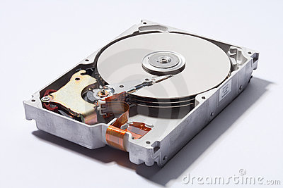
Magnetic Disk
Disk
A circular platter constructed of nonmagnetic material called substrate
Aluminium (old)
Glass (new)
Coated with a magnetisable material

Slide 6
Magnetic Disk (Cont.)
Glass
Improved surface uniformity
Increases reliability
Reduction in surface defects
Reduced read/write errors
Better stiffness – to reduce disk dynamics
Greater ability to withstand shock and damage

Slide 7
Magnetic Disk – Read/Write
Mechanisms
Recording & retrieval via conductive coil called a head
May be single read/write head or separate ones
During read/write, head is stationary, platter rotates

Slide 8
Magnetic Disk – Read/Write (Cont.)
Write
Read
Current through coil produces magnetic field
Pulses sent to head
Magnetic pattern recorded on surface below
Traditional
Magnetic field moving relative to coil produces current
Coil is the same for read and write
Contemporary
Separate read head, close to write head
Partially shielded magneto resistive (MR) sensor
Electrical resistance depends on direction of magnetic field
High frequency operation
Higher storage density and speed

Slide 9
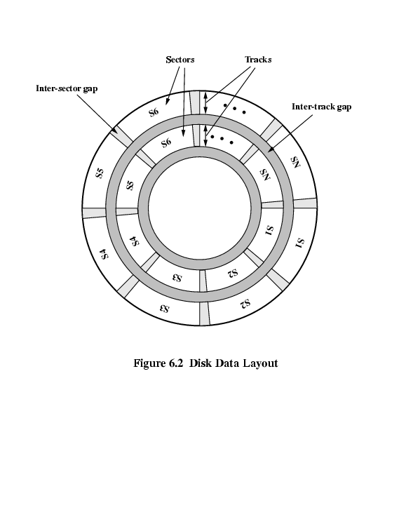
Magnetic Disk – Organization, Formatting & Layout
Term | Description
Head | A small device capable of reading from or writing to a portion of the platter rotating beneath it
Track | Organize data on the platter in a concentric set of rings
Width | Track width = head width
Gaps | separate the adjacent tracks
Sectors | Form of transferring the data Fixed length or variable length

Slide 10
Magnetic Disk - Velocity
Issue: Bit near centre of rotating disk passes fixed point slower than bit on outside of disk
Solution:
Increasing the spacing between bits of information recorded in segments of the disk
The info can then be scanned at the same rate by rotating the disk at a fixed speed known as constant angular velocity (CAV)

Slide 11
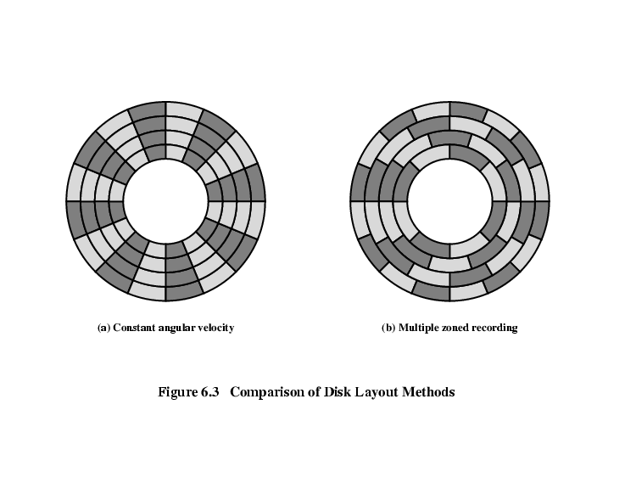
Magnetic Disk - Layout Methods Diagram

Slide 12
Magnetic Disk – Constant Angular Velocity
The disk is divided into a number of pie-shaped sectors and into a series of concentric tracks
Advantage of CAV:
The individual blocks of data can be directly addressed by tracks and sectors
Disadvantage of CAV:
The amount of data that can be stored on the long outer tracks is the only same as what can be stored on the short inner tracks

Slide 13
Magnetic Disk – Multiple Zone Recording
The surface is divided into a number of concentric zones –
The number of bits per track is constant (Within the zone)
Zones farther from the center contain more bits (since more sectors) than zones closer to the center
Advantage:
Increase density
Disadvantage:
Require complex circuitry

Slide 14
Magnetic Disk – Physical Characteristics
Head motion
Fixed head
One read write head per track
Heads mounted on fixed ridged arm
Movable head
One read write head per side
Mounted on a movable arm

Slide 15
Magnetic Disk – Physical Characteristics (Cont.)
Removable disk
Can be removed from drive and replaced with another disk
Provides unlimited storage capacity
Easy data transfer between systems
Non-removable disk
Permanently mounted in the drive

Slide 16
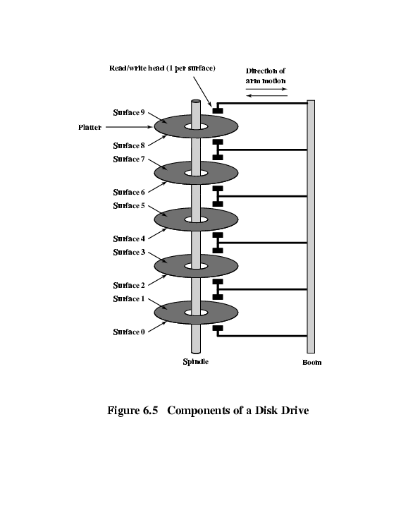
Magnetic Disk – Physical Characteristics (Cont.)
Multiple Platter
One head per side
Heads are joined and aligned
Aligned tracks on each platter form cylinders
Data is striped by cylinder
Reduces head movement
Increases speed (transfer rate)

Slide 17
Magnetic Disk – Physical Characteristics (Cont.)
Tracks and Cylinders

Slide 18
Magnetic Disk – Classifications
Head mechanism
#1 Traditional head
Positioned a fixed distance above the platter-allowing an air gap
#2 head mechanism that actually comes into physical contact with the medium during R/W operation
Used in floppy disk
8”, 5.25”, 3.5”
Small capacity
Up to 1.44Mbyte (2.88M never popular)
Slow
Universal
Cheap

Slide 19
Magnetic Disk – Classifications (Cont.)
Head mechanism
#3 Winchester
Aerodynamic gap
Generate or sense an electromagnetic field of sufficient magnitude - write/read
Used in sealed drive – free of contamination – able to reduce the risk of error
Operate closer to the disk’s surface → greater data density
Material - Aerodynamic foil - rests lightly on the platter’s surface

Slide 20
Magnetic Disk - Performance
Depends on;
Computer system
OS
Nature of the I/O channel
Disk controller hardware

Slide 21
Magnetic Disk – Performance (Cont.)
General timing of disk I/O transfer
Seek time → Moving head to correct track
(Rotational) latency/delay → Waiting for data to rotate under head
Access time = Seek + Latency
Transfer rate-the time required for the transfer data

