Slide 1

Interpolasi Newton
02

Slide 2
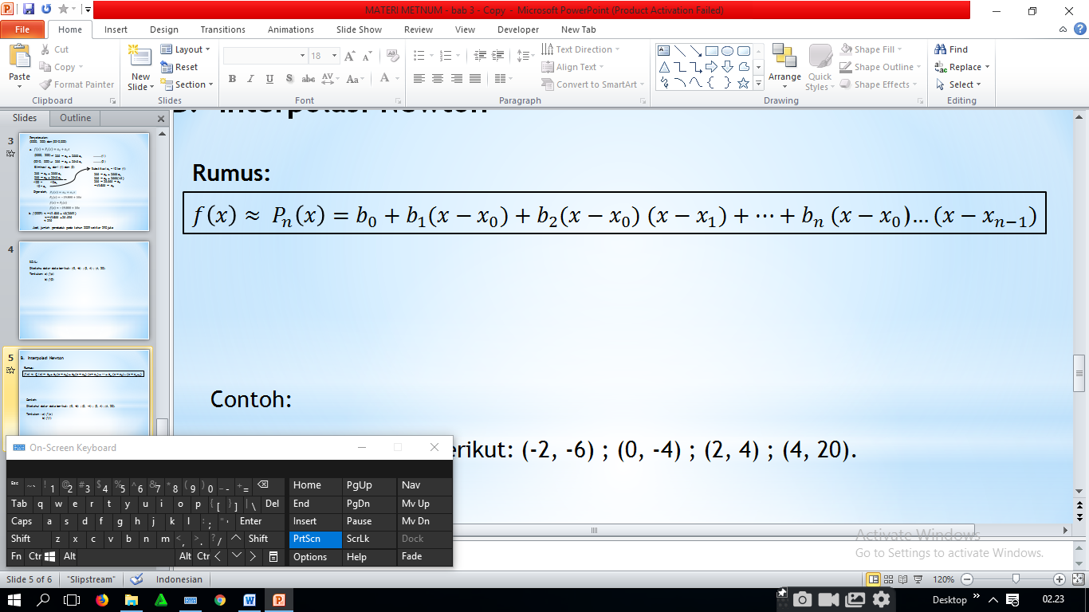
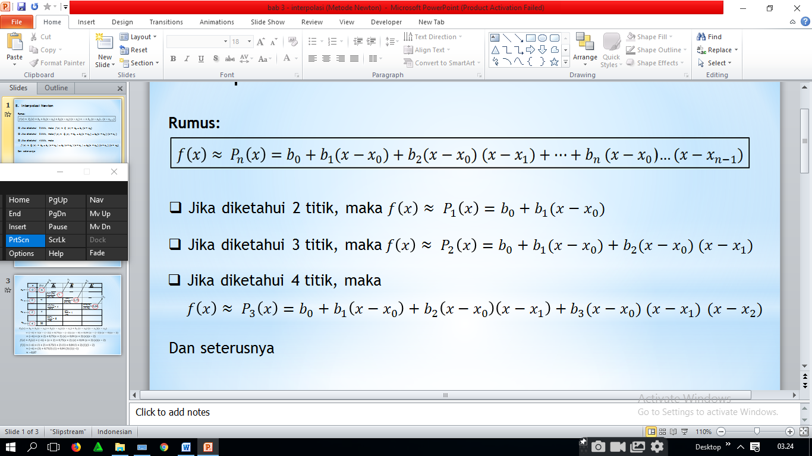
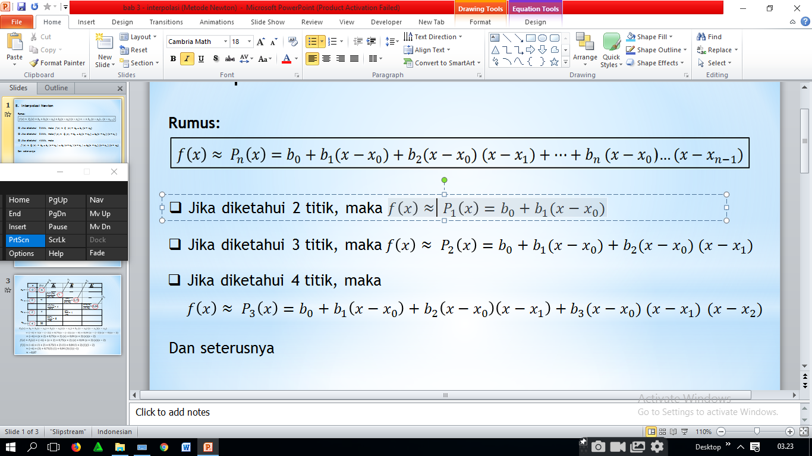
B. Interpolasi Newton
Dan seterusnya

Slide 3

CONTOH:
Diketahui data- data berikut:
(-2, -6) ; (0, -4) ; (2, 4).
Tentukan perkiraan dari : a) $f(x)$
b) f(1)

Slide 4
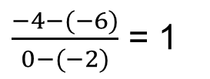
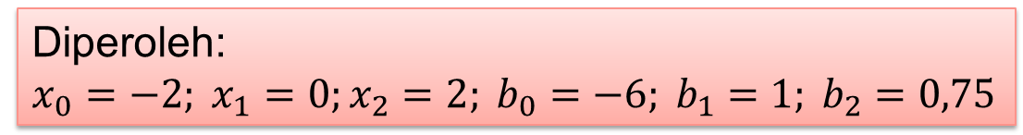

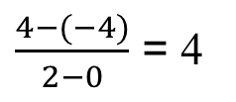

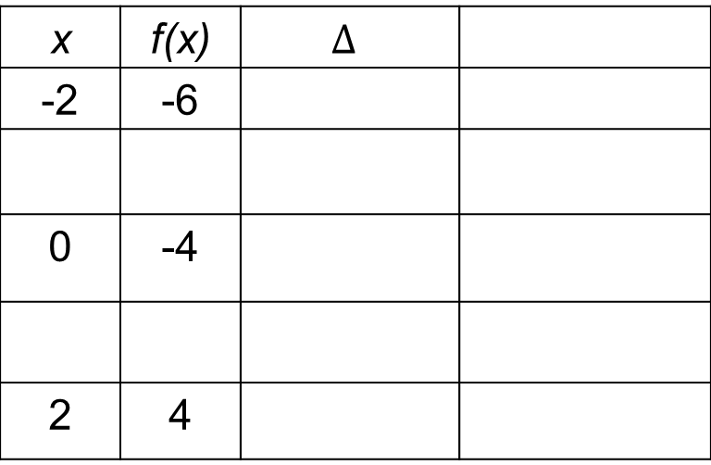




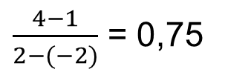

$$b_{0}$$
$$b_{1}$$
$$b_{2}$$
$$∆^{2}$$
x | f(x) | $$∆$$
-2 | -6
0 | -4
2 | 4
$$x_{0}$$
$\frac{−4−(−6)}{0−(−2)}$ = 1
$$x_{1}$$
$\frac{4−1}{2−(−2)}$ = 0,75
$\frac{4−(−4)}{2−0}$ = 4
$$x_{2}$$
Diperoleh:
$$x_{0}=−2; x_{1}=0;x_{2}=2; b_{0}=−6; b_{1}=1; b_{2}=0,75$$

Slide 5


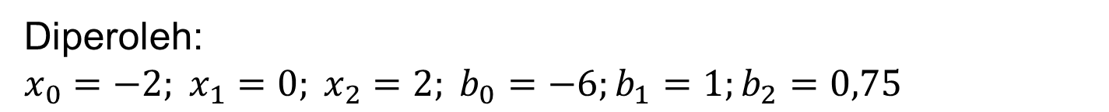

Diperoleh:
$$x_{0}=−2; x_{1}=0; x_{2}=2; b_{0}=−6;b_{1}=1;b_{2}=0,75$$
(a) $f\left(x\right)≈P_{2}\left(x\right)=b_{0}+b_{1}\left(x−x_{0}\right)+b_{2}\left(x−x_{0}\right)\left(x−x_{1}\right)$
$$=(−6)+1\left(x−\left(−2\right)\right)+0,75\left(x−(−2)\right)\left(x−0\right)$$
$$=(−6)+\left(x+2\right)+0,75\left(x+2\right)\left(x\right)$$
$$Jadi, f(x)≈(−6)+\left(x+2\right)+0,75\left(x+2\right)\left(x\right)$$
$$(b) f(1)≈(−6)+\left(1+2\right)+0,75\left(1+2\right)\left(1\right)$$
$$≈(−6)+\left(3\right)+0,75\left(3\right)\left(1\right)$$
$$≈−0,75$$

Slide 6
SOAL
?
Diketahui data- data berikut:
(0,1) ; (1,1) ; (2, 2); (4, 5). Tentukan f(1,2)
Jawabannya:
1,136

Slide 7

TUGAS
Carilah nilai ln 2 dengan metode intrpolasi Newton berdasarkan data sebagai berikut.
$$\ln{1=0;\ln{3=1,099; }ln{5=1,609}}$$

Slide 8
TERIMA KASIH
Ada pertanyaan???
Please keep this slide for attribution.

