Slide 1
Pertemuan 6 Pengantar Sistem dan Teknologi Informasi
Khusnul Khotimah, S.Kom., M.T.I.

Slide 2
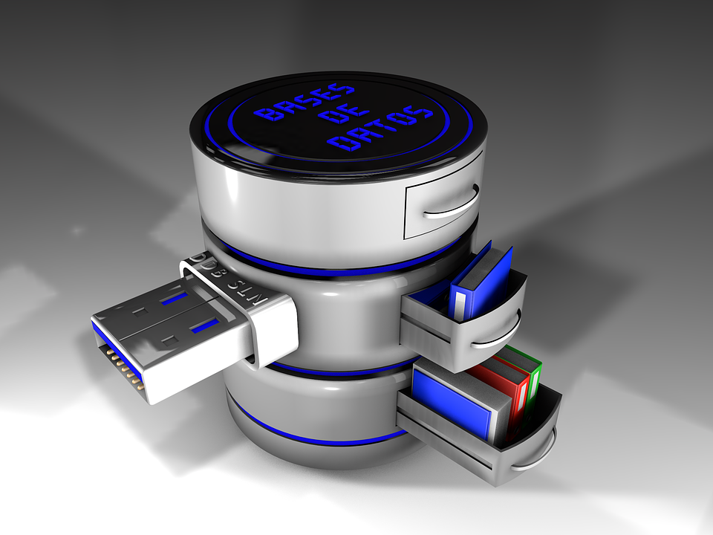
Basis Data & DBMS
Materi 6
Khusnul Khotimah, S.Kom., M.T.I
Basis Data
Notes:
Custom animation effects: shrink picture circle with text
(Intermediate)
To reproduce the picture effects on this slide, do the following:
On the Home tab, in the Slides group, click Layout, and then click Blank.
On the Insert tab, in the Illustrations group, click Picture. In the Insert Picture dialog box, select a picture, and then click Insert.
On the slide, select the picture. Under Picture Tools, on the Format tab, in the Picture Styles group, click Picture Shape, and then under Basic Shapes click Oval (first row, first option from the left).
Select the picture-filled oval. Under Picture Tools, on the Format tab, in the bottom right corner of the Size group, click the Size and Position dialog box launcher. In the Size and Position dialog box, on the Size tab, resize or crop the picture as needed so that under Size and rotate, the Height box is set to 6” and the Width box is set to 6”. Resize the picture under Size and rotate by entering values into the Height and Width boxes. Crop the picture under Crop from by entering values into the Left, Right, Top, and Bottom boxes.
Under Picture Tools, on the Format tab, in the Picture Styles group, click Picture Effects, point to Glow, and then under Glow Variations click Accent color 1, 18 pt glow (fourth row, first option from the left).
Under Picture Tools, on the Format tab, in the Picture Styles group, click Picture Effects, point to Glow, point to More Glow Colors, and then under Theme Colors click White, Background 1 (first row, first option from the left).
On the Home tab, in the Drawing group, click the Format Shape dialog box launcher. In the Format Picture dialog box, click Shadow in the left pane. In the Shadow pane, click the button next to Presets, under Inner click Inside Diagonal Bottom Left (third row, first option from the left), and then do the following:
In the Transparency box, enter 50%.
In the Blur box, enter 8 pt.
In the Angle box, enter 135°.
In the Distance box, enter 8 pt.
On the Insert tab, in the Text group, click Text Box. On the slide, drag to draw a text box.
Enter text, and then select the text. On the Home tab, in the Font group, do the following:
In the Font list, select Candara.
In the Font Size box, enter 30.
Click the arrow next to Font Color, and then click Black, Text 1, Lighter 25% (fourth row, second option from the left).
On the Home tab, in the Paragraph group, click Align Text Left.
On the slide, select the text box. Under Drawing Tools, on the Format tab, in the WordArt Styles group, click Text Effects, point to Reflection, and then under Reflection Variations click Tight Reflection, touching (first row, first option from the left).
Drag the text box onto the right half of the slide.
With the text box still selected, on the Home tab, in the Drawing group, click Arrange, and then do the following:
Point to Align, and then click Align to Slide.
Point to Align, and then click Align Right.
Point to Align, and then click Align Middle.
Click Send to Back.
To reproduce the animation effects on this slide, do the following:
On the Animations tab, in the Animations group, click Custom Animation.
On the slide, select the picture. In Custom Animation task pane, do the following:
Click Add Effect, point to Entrance, and then click More Effects. In the Add Entrance Effect dialog box, under Basic, click Wheel.
Select the animation effect (wheel effect for the picture). Under Modify: Wheel, do the following:
In the Start list, select With Previous.
In the Spokes list, select 1 Spoke.
In the Speed list, select Medium.
On the slide, select the picture. In Custom Animation task pane, do the following:
Click Add Effect, point to Entrance, and then click More Effects. In the Add Entrance Effect dialog box, under Subtle, click Faded Zoom.
Select the second animation effect (faded zoom effect for the picture). Under Modify: Faded Zoom, do the following:
In the Start list, select With Previous.
In the Speed list, select Medium.
On the slide, select the picture. In Custom Animation task pane, do the following:
Click Add Effect, point to Emphasis, and then click More Effects. In the Add Emphasis Effect dialog box, under Basic, click Grow/Shrink.
Select the third animation effect (grow/shrink effect for the picture). Click the arrow to the right of the selected effect, and then click Effect Options. In the Grow/Shrink dialog box, do the following:
On the Effect tab, under Settings, do the following:
In the Size list, in the Custom box, enter 95%, and then press ENTER.
Select Smooth Start.
Select Smooth End.
Select Auto-reverse.
On the Timing tab, do the following:
In the Start list, select After Previous.
In the Speed box, enter 0.3 seconds.
On the slide, select the picture. In Custom Animation task pane, do the following:
Click Add Effect, point to Emphasis, and then click More Effects. In the Add Emphasis Effect dialog box, under Basic, click Grow/Shrink.
Select the fourth animation effect (grow/shrink effect for the picture). Under Grow/Shrink, do the following:
In the Start list, select After Previous.
In the Size list, select Smaller.
In the Speed list, select Medium.
On the slide, select the picture. In Custom Animation task pane, do the following:
Click Add Effect, point to Motion Paths, and then click Left.
Select the fifth animation effect (left motion path for the picture). Under Modify: Left, do the following:
In the Start list, select With Previous.
In the Speed list, select Medium.
On the slide, select the text box. In the Custom Animation task pane, do the following:
Click Add Effect, point to Entrance, and then click More Effects. In the Add Entrance Effect dialog box, under Subtle, select Fade.
Select the sixth animation effect (fade effect for the text box). Click the arrow to the right of the selected effect, and then click Timing. In the Fade dialog box, on the Timing tab, do the following:
In the Start list, select With Previous.
In the Delay box, enter 1.5.
In the Speed list, select 1 seconds (Fast).
On the slide, select the text box. In Custom Animation task pane, do the following:
Click Add Effect, point to Motion Paths, and then click Left.
Select the seventh animation effect (left motion path for the text box). Under Modify: Left, do the following:
In the Start list, select With Previous.
In the Speed list, select Fast.
On the slide, right–click the selected motion path for the text box, and then click Reverse Path Direction.
To reproduce the rectangle on this slide, do the following:
On the Home tab, in the Drawing group, click Shapes, and then under Rectangles click Rectangle (first option from the left). On the slide, drag to draw a rectangle.
Select the rectangle. Under Drawing Tools, on the Format tab, in the Size group, do the following:
In the Shape Height box, enter 1.54”.
In the Shape Width box, enter 10”.
Under Drawing Tools, on the Format tab, in the Shape Styles group, click the arrow next to Shape Outline, and then click No Outline.
Under Drawing Tools, on the Format tab, in the bottom right corner of the Shape Styles group, click the Format Shape dialog box launcher. In the Format Shape dialog box, click Fill in the left pane, select Gradient fill in the Fill pane, and then do the following:
In the Type list, select Linear.
Click the button next to Direction, and then click Linear Right (first row, fourth option from the left).
Under Gradient stops, click Add or Remove until two stops appear in the drop-down list.
Also under Gradient stops, customize the gradient stops that you added as follows:
Select Stop 1 from the list, and then do the following:
In the Stop position box, enter 0%.
Click the button next to Color, and then under Theme Colors click White, Background 1 (first row, first option from the left).
In the Transparency box, enter 88%.
Select Stop 2 from the list, and then do the following:
In the Stop position box, enter 100%.
Click the button next to Color, and then under Theme Colors click White, Background 1 (first row, first option from the left).
In the Transparency box, enter 43%.
On the Home tab, in the Drawing group, click Arrange, and then do the following:
Point to Align, and then click Align to Slide.
Point to Align, and then click Align Middle.
Point to Align, and then click Align Center.
Click Send to Back.
To reproduce the background effects on this slide, do the following:
Right-click the slide background area, and then click Format Background. In the Format Background dialog box, click Fill in the left pane, select Gradient fill in the Fill pane, and then do the following:
In the Type list, select Radial.
Click the button next to Direction, and then click From Center (third option from the left).
Under Gradient stops, click Add or Remove until two stops appear in the drop-down list.
Also under Gradient stops, customize the gradient stops that you added as follows:
Select Stop 1 from the list, and then do the following:
In the Stop position box, enter 0%.
Click the button next to Color, and then under Theme Colors click White, Background 1 (first row, first option from the left).
Select Stop 2 from the list, and then do the following:
In the Stop position box, enter 100%.
Click the button next to Color, and then under Theme Colors click Black, Text 1, Lighter 50% (second row, second option from the left).

Slide 3
Konsep Dasar
Pendahuluan
Sistem berkas atau pengarsipan adalah :
Suatu system untuk mengetahui bagaimana cara menyimpan data dari file tertentu dan organisasi file yang digunakan.
Sistem akses :
Cara untuk mengambil informasi dari suatu file
Organisasi file :
Teknik yang digunakan untuk menggambarkan dan menyimpan pada file

Slide 4
Konsep Sistem Basis Data
sebuah tatanan (keterpaduan) yang terdiri atas sejumlah komponen fungsional (dengan satuan fungsi/tugas tertentu) yang saling berhubungan dan secara bersama-sama bertujuan untuk memenuhi suatu proses / pekerjaan tertentu.
SISTEM

Slide 5
Pengertian Sistem Basis Data
Data
Data dapat diartikan merupakan representasi dari fakta dunia yang mewakili suatu obyek (manusia, barang, peristiwa, keadaan dsb) yang direkam dalam bentuk angka, huruf, simbol, teks, gambar, bunyi atau kombinasinya
Basis Data
Sekumpulan data yang terintegrasi yang diorganisasi untuk memenuhi kebutuhan para pemakai di dalam suatu organisasi.
DBMS (Database Management Systems)
Perangkat lunak yang menangani semua pengaksesan ke database.

Slide 6
Perbedaan
Program Oriented
Kaku
File Manajemen Tadisional
Kerangkapan Data
Data Oriented Terkontrolnya
Luwes
File Manajemen Basisdata
Kerangkapan Data
dimimalisir

Slide 7
Kelemahan
File Manajemen Tadisional | File Manajemen Basisdata
Timbulnya data rangkap & Ketidak konsistenan | Storage yang digunakan besar
Data tidak dapat digunakan bersama | Dibutuhkan tenaga spesialis
Kesukaran dalam peng-aksesan data | Softwarenya mahal
Tidak Fleksibel | Kerusakan pada sistem database dapat mempengaruhi departeman lain yang terkait.
Data tidak standar

Slide 8
Keuntungan dan Tujuan Manajemen Basisdata
Keuntungan
Tujuan
Terkontrolnya kerangkapan data
Terpeliharanya kekonsistenan data
Data dapat dipakai bersama-sama
Data dapat distandarisasikan
Keamanan data dapat terjamin
Integritas data terpelihara
Data independence
Kecepatan dan Kemudahan (Speed)
Efisiensi Ruang Penyimpanan (Space)
Keakuratan (Accuracy)
Ketersediaan (Availability)
Kelengkapan (Completeness)
Keamanan (Security)
Kebersamaan (Sharability)

Slide 9
Istilah dalam Database
Enterprise
Entitas
Sekumpulan obyek yang mempunyai karakteristik sama dan bisa dibedakan dari lainnya. Obyek dapat berupa barang, orang, tempat atau suatu kejadian Contoh : pegawai, mobil, nilai dsb
Atribut (Elemen Data)
Deskripsi data yang bisa mengidentifikasikan entitas Contoh : entitas mobil adalah no. mobil, merk mobil, warna mobil dsb.
4. Nilai Data (Data Value)

Slide 10
5. Record Data
Kumpulan dari field yang berhubungan satu sama lain
6. File
Kumpulan dari record yang menggambarkan himpunan Entitas
7. Basis Data
Kumpulan file yang digunakan oleh program aplikasi serta membentuk hubungan tertentu di antara record-record di file-file tersebut
8. Kunci Elemen Data (Key Data Elemen)
Kunci Elemen Record merupakan kunci yang dipakai untuk menemukan Record tersebut pada waktu akses.
Jenis-jenis key: Primary key, Secondary key, Candidate key, Alternate key, Composite key, Foreign key

Slide 11
Key
1. Primary key
Field yang mengidentifikasikan sebuah record dalam file
Bersifat unik
2. Secondary key
Field yang mengidentifikasikan sebuah record dalam file
Tidak bersifat unik
Primari Key
NPM | Nama | Alamat
20598842001 | Dadang | Kotabumi Kota
20598842002 | Rika | Ketapang
20598842003 | Rika | Bandar Jaya
NPM | Nama | Alamat
20598842001 | Dadang | Kotabumi Kota
20598842002 | Rika | Ketapang
20598842003 | Rika | Bandar Jaya
Secondary Key

Slide 12
3. Candidate key
Field-field yang bisa dipilih (dipakai) menjadi primary key
NPM | Nama | Alamat | Kd_Kelas | Nama_Kelas
20598842001 | Dadang | Kotabumi Kota | 3A | Semester 3 Kelas A
20598842002 | Rika | Ketapang | 3A | Semester 3 Kelas A
20598842003 | Rika | Bandar Jaya | 3B | Semester 3 Kelas B
Candicate key

Slide 13
4. Composite key
Primary key yang dibentuk
dari beberapa field
5. Foreign key
Field yang bukan key, tetapi adalah
key pada file yang lain.
HARI | RUANG | MATA KULIAH
Senin | ARFL1R2 | Matematika STI
Senin | ARFL1R3 | Basis Data
Senin | ARFL1R4 | ISBD
Kd_Doden | Nama Dosen
D001 | Venty Meilinasari, M.Pd.
D002 | Khusnul Khotimah, M.T.I.
D003 | Novekawati, M.H.
Primary key
Foreign key
Secondary Key
Kode_MK | MATA KULIAH | Sks | Kd_Doden
PSTI013 | Matematika STI | 3 | D001
PSTI023 | Basis Data | 3 | D002
PSTI032 | ISBD | 2 | D003

Slide 14
Komponen Sistem Basis Data
Biasanya berupa perangkat komputer standar, media penyimpan sekunder dan media komunikasi untuk sistem jaringan.
Hardware
Yakni merupakan perangkat lunak yang memfungsikan, mengendalikan seluruh sumber daya dan melakukan operasi dasar dalam sistem komputer. Harus sesuai dengan DBMS yang digunakan.
Operating System
Database
DBMS
Basis data yang mewakili sistem tertentu untuk dikelola. Sebuah sistem basis data bisa terdiri dari lebih dari satu basis data.
User
(Database Management System). Perangkat lunak yang digunakan untuk mengelola basis data. Contoh kelas sederhana: dBase, Foxbase, Rbase, MS. Access, MS. Foxpro, Borland Paradox. Contoh kelas kompleks: Borland-Interbase, MS. SQL Server, Oracle, Informix, Sybase.
Optional Software
Orang-orang yang berinteraksi dengan sistem basis data, mulai dari yang merancang sampai yang menggunakan di tingkat akhir.
Perangkat lunak pelengkap yang mendukung. Bersifat opsional.

Slide 15
Pengguna Database
System Engineer
Database Administrator (DBA)
Orang yang bertugas mengelola sistem database secara keseluruhan
Programmer
Orang yang bertugas membuat program aplikasi yang mengakses database, dengan menggunakan bahasa pemrograman, seperti Clipper, VB, Oracle baik secara batch maupun online untuk berinteraksi dengan komputer
Pemakai Akhir (End-user)
Orang yang mengakses database melalui terminal, dengan menggunakan query-language atau program aplikasi yang dibuatkan oleh programmer

Slide 16
JENIS FILE (Berdasarkan fungsinya):
Master File
Berisi data statis
Data tentang satu sisi dari organisasi
Berisi data historis
Isinya relatif permanen
Misal :
Mahasiswa, Dosen, Matakuliah
Pelanggan, Persediaan Barang, Karyawan
2. Transaction File
Berisi data yang akan mengupdate master file
Berisi kejadian atau perubahan terhadap sesuatu, yang statusnya tersimpan dalam master file

Slide 17
3. REPORT FILE
Berisi data yang bentuknya telah disesuaikan untuk kepentingan user
Data yang akan ditampilkan pada monitor
Data yang akan dicetak
Dihasilkan oleh:
Report writer
Application program
4. WORK FILE
Temporary file
File sementara
File kerja
Berisi sesuatu yang tidak permanen
Isinya hanya dipakai sesaat saja
Untuk memindahkan data dari satu program ke program yang lain

Slide 18
5. PROGRAM FILE
Berisi perintah untuk memproses data
Bisa berisi perintah dalam:
High Level Language
Low Level Language
Machine Language
Job Control Language
Perintah bisa berbentuk:
Source Code
Hasil Kompilasi
Hasil proses lainnya
6. TEXT FILE
Berisi ALPHANUMERIC & GRAPHIC DATA
Berasal dari program text editor
Hanya dapat diproses oleh program text editor

Slide 19
Bahasa Basis Data dikelompokkan ke dalam 2 bentuk :
1. Data Definition Language (DDL)
Dengan bahasa ini kita dapat membuat tabel baru, membuat indeks, mengubah tabel, menentukan struktur penyimpanan tabel dsb.
2. Data Manipulation Language (DML).
Berguna untuk melakukan manipulasi dan pegambilan data pada suatu basis data. Berupa:
penyisipan/penambahan data baru (insert)
penghapusan data (delete)
pengubahan data (update)

Slide 20
Tugas
1. Data Definition Language (DDL)
Dengan bahasa ini kita dapat membuat tabel baru, membuat indeks, mengubah tabel, menentukan struktur penyimpanan tabel dsb.
2. Data Manipulation Language (DML).
Berguna untuk melakukan manipulasi dan pegambilan data pada suatu basis data. Berupa:
penyisipan/penambahan data baru (insert)
penghapusan data (delete)
pengubahan data (update)

Slide 21
End

