Slide 1





TAG FORM

Slide 2
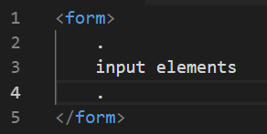
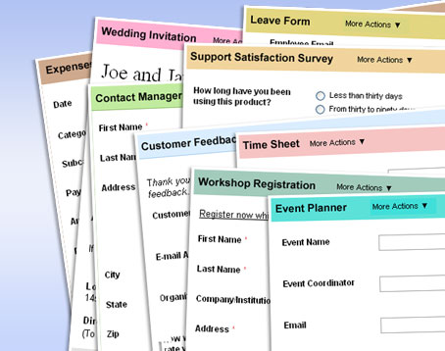
STRUKTUR DASAR FORM

Slide 3

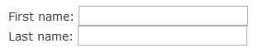
FORM – TEXTFIELDS

Slide 4
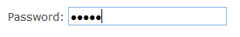
FORM – PASSWORD FIELDS

Slide 5

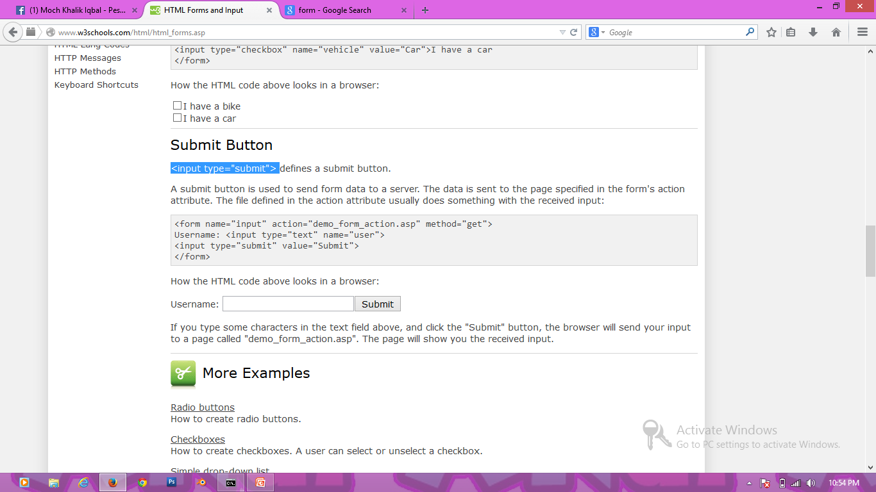
FORM – BUTTON

Slide 6

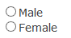
FORM – RADIO BUTTON

Slide 7

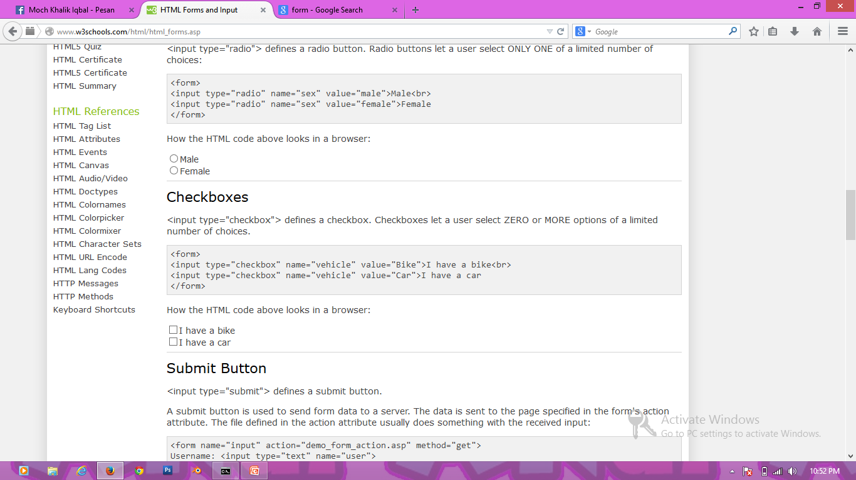
FORM – CHECK BOX

Slide 8

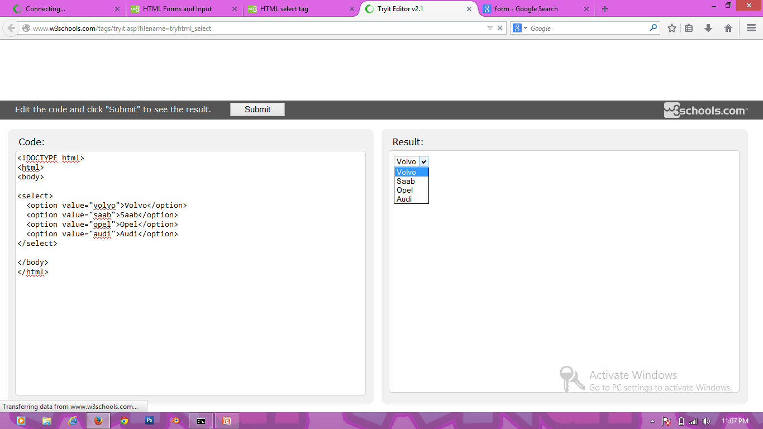
FORM – SELECT

Slide 9
FORM – SELECT

