Slide 2
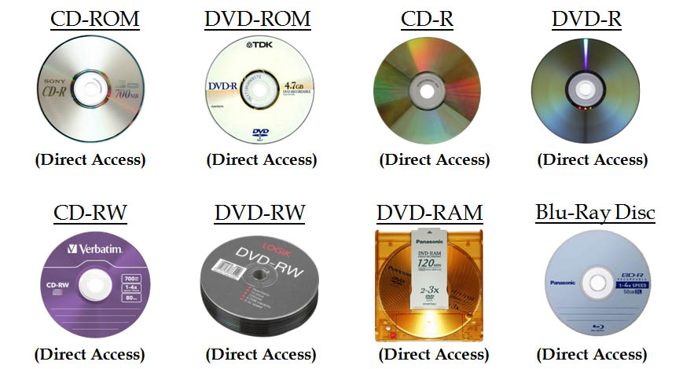
Optical Storage

Slide 3
Optical Storage
Originally for audio
650Mbytes giving over 70 minutes audio
The disk is formed from a resin such as polycarbonate.
Record data digitally (music/computer data)
Data recorded as a series of microscopic pits on the surface of the polycarbonate

Slide 4
Optical Storage (Cont.)
Organized in a single spiral track in a sequence of blocks
Sectors near the outside of the disk are the same length as those near the inside
Info is packed evenly across the disk in segments of the same size - scanned at the same rate by rotating the disk as a variable speed
The pits are then read by the laser as a constant linear velocity (CLV)

Slide 5
Optical Storage - Writing
Create a master disk – high-intensity laser
Use master to make a die to stamp out copies onto polycarbonate
Pitted surface - coated with a highly reflective surface (aluminium / gold)
Shiny surface - protected against dust and scratches by suing a top coat of clear acrylic
A label can be silkscreened onto the acrylic

Slide 6
Optical Storage - Reading
Low-powered laser – retrieve information from CD
Laser - shines through the clear polycarbonate
Motor - spins the disk past it
Intensity of the reflected light of the laser changes as it encounters a pit
Lands - areas between pits
A land is smooth surface which reflects back at higher intensity
Change between pits and lands is detected by a photosensor -convert into a digital signal
The sensor tests the surface at regular intervals
The beginning or end of a pit represents a 1, when no change in elevation occur between intervals, a 0 is recorded

Slide 7
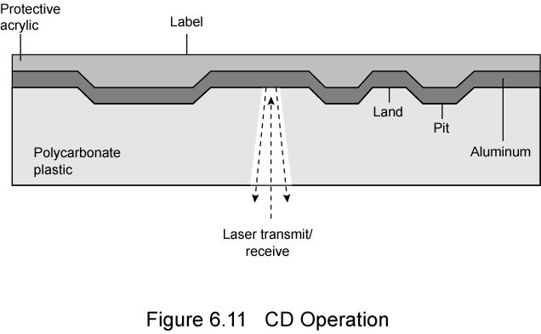
Optical Storage - Reading

Slide 8
Optical Storage – Types
CD-ROM
CD-R
CD-RW
DVD

Slide 9
Optical Storage – CD-R
CD-Recordable
Write Once Read only Memory (WORM)
Compatible with CD-ROM drives

Slide 10
Optical Storage – CD-RW
Erasable
Getting cheaper
Mostly CD-ROM drive compatible
Can be rewritten and can used as secondary storage similar to magnetic disk

Slide 11
Optical Storage – DVD
Digital Video Disk
  Used to indicate a player for movies
    Only plays video disks
Digital Versatile Disk
  Used to indicate a computer drive
    Will read computer disks and play video disks

Slide 12
Optical Storage – DVD
Technology
Multi-layer
Very high capacity (4.7G per layer)
Full length movie on single disk
  Using MPEG compression

Slide 13
Optical Storage – DVD (Cont.)
High Definition
Designed for high definition videos
  Much higher capacity than DVD
    Shorter wavelength laser
      Blue-violet range
  Smaller pits
HD-DVD
  15GB single side single layer
Blu-ray
  Data layer closer to laser
    Tighter focus, less distortion, smaller pits
  25GB on single layer
  Available read only (BD-ROM), Recordable once (BR-R) and re-recordable (BR-RE)

Slide 14
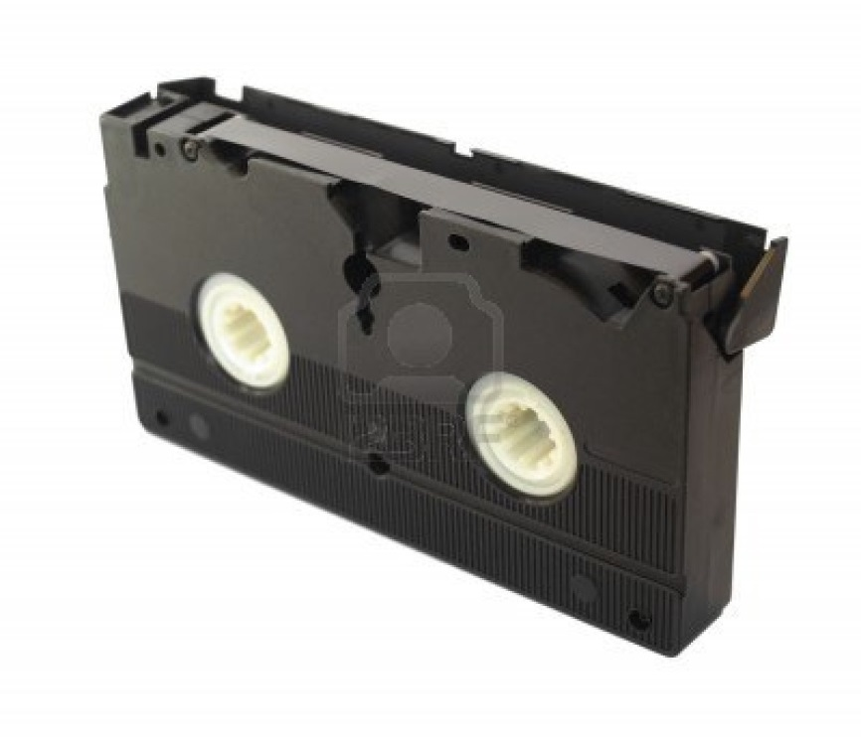
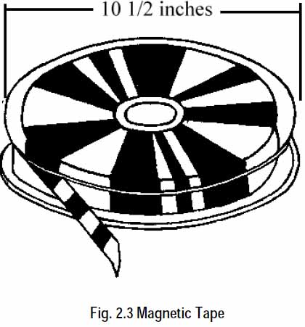
Magnetic Tape

Slide 15
Magnetic Tape
Tape system use the same reading/writing technique as disk system
Made from polyester tape coated with magnetizable material
Data on the tape are structured as a number of parallel tracks running lengthwise
Serial access
Slow
Very cheap
Backup and archive

Slide 16
Magnetic Tape (Cont.)
Older version - parallel recording
Modern version - serial recording
Have 9 tracks
Store one byte at a time with additional parity bit
Later system have 18 or 36 tracks
Data are laid out as a sequence of bits along each track similar to magnetic disks
Data read and write in contiguous blocks called physical records on a tape
Typical recording technique used in serial tapes is referred as serpentine recording

