Slide 1




INTRODUCTION TO ALGEBRA
Yoga Dwi Windy KN, S.Pd., M.Sc.
Prodi Pendidikan Matematika
FKIP UNMUH Jember

Slide 2
Content
Objectives
A Brief History about Algebra
Introduction
Algebraic Expressions
Terms - Like and Unlike Terms
Variables and Constants
Coefficients
Rules of Operations of Algebraic Expressions
Addition of Algebraic Expressions
Subtraction of Algebraic Expressions
Evaluation of Algebraic Expressions
Summary

Slide 3


Learning Objectives
You are expected to:
differentiate term, variables, constant, and coefficients
expand and simplify algebraic expressions
This Photo by Unknown Author is licensed under CC BY-SA

Slide 4
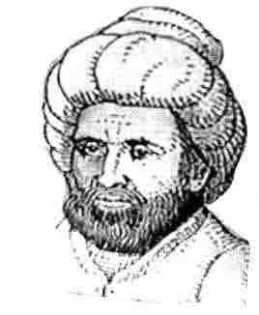
A Brief History of Algebra
Algebra began its journey as a branch of Mathematics around 1550 BC (around 5500 years ago) with people in Egypt using symbols to denote unknown numbers.
The word ‘algebra’ is derived from the title of the book ‘Hisab Al-jbar w’al-muqabalah’ written about 825AD by an Arab mathematician Mohammed Ibn Musa Al Khwarizmi of Baghdad. From which we get the word algebra (meaning 'restoration of broken parts'). This book included many word problems, especially dealing with inheritance.
Al-Khwarizmi is also called the “Father of Algebra”. He also helped establish widespread use of Hindu-Arabic numbers.
Meet the HERO
CLICK

Slide 5

What is Algebra?
The part of the mathematics in which letters and other general symbols are used to represent numbers and quantities in formulae and equations.
Notes:
Dunia tidak lagi stagnan. Cara belajar sudah berbeda. Teknologi mengubah segalanya. Berubah dan berinovasi menjadi kebutuhan mendesak.
Adanya kemendesakan untuk:
a. Pelatihan berpikir kritis, kreatif, kolaboratif
b. Keberanian untuk memasuki wilayah-wilayah baru
c. Kesediaan dan keterbukaan untuk beradaptasi.
Hal-hal tersebut akan menentukan apakah generasi berikut bisa bertahan hidup atau tidak.

Slide 6
6 + q = 10
q = 4
Can you solve?
2 + x = 10
x = 8
So letters in Maths are just missing numbers.
When letters of alphabet represent numbers, they are called Literal Numbers.

Slide 7
Try this yourself!
Use algebra to write:
2 less than x
4 more than d
6 together with a
y more than g
z less than q
m less than 5
x – 2
d + 4
a + 6
y + g
q - z
5 - m

Slide 8
What is Algebraic Expression?
A combination of numbers, literal numbers and the fundamental operations is called
an Algebraic Expression
Example:
5x + 3y – 4 → 5x, 3y and 4 are the parts separated by the symbols (+) and (-) signs.

Slide 9

Activity - 1
How many sweets are in this bag?
n

Slide 10
We don’t know!
We have to call it ‘n’ for any number!
n

Slide 11
How many sweets are here??
3 bags of n and 2 more!
We write this as
3n + 2
n
n
n

Slide 12
Now, write the expression for the number of sweets in the picture given below!
n
n
n
n
n
n
Answer → 6n + 5

Slide 13

Parts of An Algebraic Expression

Slide 14
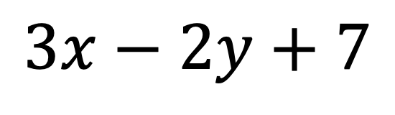
Term
$$3x−2y+7$$
What is a Term?
Parts of an algebraic expression separated by the symbols (+) and (-) are called the Terms of an algebraic expression.

Slide 15
Terms
UNLIKE TERMS
Terms having different variables.
Examples : 7x , -5y , 5x²
They have different variables (such as x, y, x²) and therefore are unlike terms.
LIKE TERMS
Terms having the same variables.
Examples : 4x, 7x , -2x
They have the same variable ‘x’ and therefore are like terms.

Slide 16
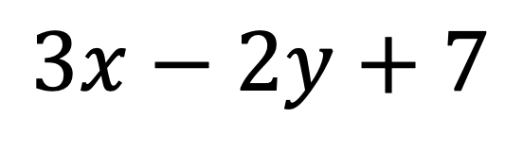
Variables
$$3x−2y+7$$
What is a Variable?
A variable is a symbol which represents a quantity that can change.

Slide 17
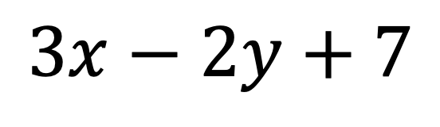
Constant
$$3x−2y+7$$
What is a Constant?
A quantity which does not change its value is called Constant.

Slide 18
Coefficients
$$3x−2y+7$$
What is a Coefficient?
The number that is multiplied by the variable is called Coefficient.

Slide 19
For the expression: 7x + 3y – 9
Name:
    a term
    the constant
    a coefficient
    a variable

Slide 20
ANSWER
For the expression: 7x + 3y – 9
Name:
    a term : 7x or 3y or -9
    the constant : -9
    a coefficient : 7 or 3
    a variable : x or y

Slide 21
NAMES OF
Algebraic Expression

Slide 22
OPERATIONS ON
ALGEBRAIC EXPRESSIONS
Two or more terms can only be added or subtracted if they are like terms.
Unlike terms cannot be added or subtracted.

Slide 23
Addition of algebraic expressions
Nissa has some toys, we do not know how many toys she has….
so we can say ‘Nissa has x toys’
If Nissa buys 6 more toys, how many toys has she now got?
x + 6

Slide 24
Addition of Monomials
Like Terms
Example:
Add 5x, 4x and 3x
5x + 4x + 3x = (5+4+3)x
= 12x
(Adding numerical coefficient of each monomial)

Slide 25
Addition of Monomials
Unlike Terms
Example:
Add 4x, 2y, -y and 3x
4x + 2y + (-y) + 3x
= (4x + 3x) + (2y – y)
= 7x + y
We have unlike terms
Regrouping like terms

Slide 26
Addition of BinomiAls
Two ways to solve addition of algebraic expressions:-
Horizontal Method:
Column Method:

Slide 27
1. Horizontal Method
In this method, all expressions are written in a horizontal line and then the terms are arranged to collect all the groups of like terms and then added.
Example:
(3x² + 5x – 3) + (x² – 5x + 1)
= 3x² + 5x – 3 + x² – 5x + 1 (remove the brackets, identify the like terms)
= 3x² + x² + 5x – 5x – 3 + 1 (group the like terms together)
= 4x² + 0 - 2
= 4x² – 2 (Ans.)

Slide 28
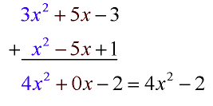
2. Column Method
In this method each expression is written in a separate row such that there like terms are arranged one below the other in a column. Then the addition of terms is done column wise.
Example :

Slide 29

Subtraction of algebraic expressions
Yola catches x fish.
Arga takes 3 away from him.
How many fish does Yola now have?
x – 3

Slide 30
Subtraction of algebraic expressions
The steps for subtraction of algebraic expressions are:
Arrange the terms of the given expression in the same order.
Write the given expressions in such a way that the like terms occur one below the other, keeping the subtracted in the second row.
Change the sign of each term in the lower row from + to – and – to +.
With new signs of the terms of lower row, add column wise.

Slide 31
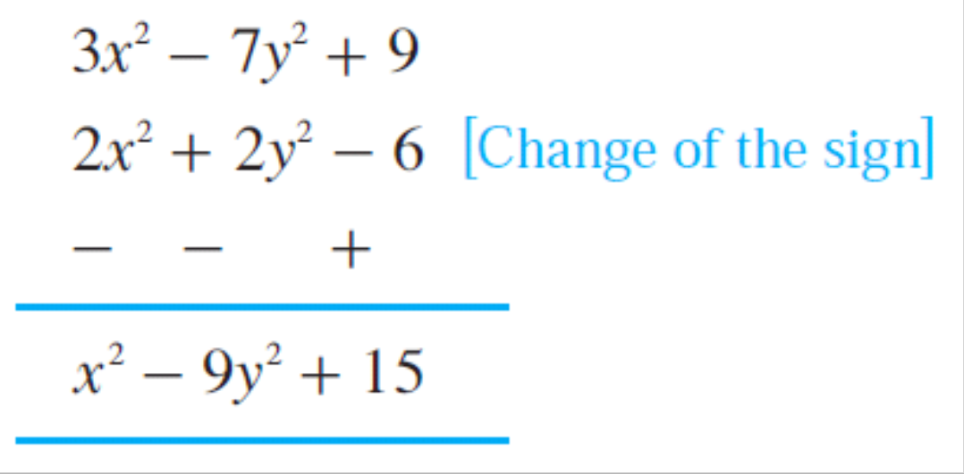
Example of Subtraction
(2x² + 2y² - 6) from (3x² - 7y² + 9)
Horizontal Method
(3x² – 7y² + 9) - (2x² + 2y² - 6)
= 3x² – 7y² + 9 - 2x² - 2y² + 6
= (3x² - 2x²) + (– 7y² - 2y²) + (9 + 6)
= x² – 9y² + 15
2. Column Method

Slide 32
Try it Yourself !
4a – 5a² + 2a + 3a² =
2) 5a + 2b – 10a – 3b =
3) 3y – 4x – 5y + x =
4) -4x² + 7x – 10x² =
5) r² + 2r – 7r² – 7r² – 2r =
6a – 2a²
- 5a –b
- 3x-2y
7x -14x²
-13r²

Slide 33
Evaluation of Algebraic Expressions
Evaluate means to find the value of an algebraic expression by substituting numbers in for variables.
Example:
What is the value of x + 4 when x = 2?
x = 2
x + 4
= 2 + 4
= 6

Slide 34
If Siti was born in 2002. You can find out what year Sitiwill turn 18 by adding the year she was born to her age.
In this case, if we add 18 to add to 2002,
2002 + 18 = 2020
Similarly, x can be Siti’s age. Therefore, Siti turns x year old and the expression is given by,
2002 + x

Slide 35
Evaluate the expression for the given value of the variable:
4x – 3 for x = 2
4x – 3 for x = 2
4(2) – 3 Substitute for x
= 8 – 3 Multiply
= 5 Subtract

Slide 36
Try It Yourself!
Evaluate x + 4 for each value of x.
a. x = 14
b. x = 83.
2. The expression 7d gives the number of days in d weeks. Calculate the number of days in 52 weeks.

Slide 37
ANSWER
Evaluate x + 4 for each value of x.
a. x = 14
x + 4 = 14 + 4 (substitute x for 14)
= 18
2. Evaluate x + 4 for each value of x.
b. x = 83.
x + 4 = 83 + 4 (substitute x for 83)
= 87

Slide 38
ANSWER
2. The expression 7d gives the number of days in d weeks. Calculate the number of days in 52 weeks?
The expression is given by 7d
In this case, d = 52
7d = 7(52)
= 364

Slide 39
Can You Find the Solution?
1. Think of a number
2. Multiply it by 2
3. Add 10 to the number
4. Divide total by 2
5. Subtract number you picked from total

Slide 40
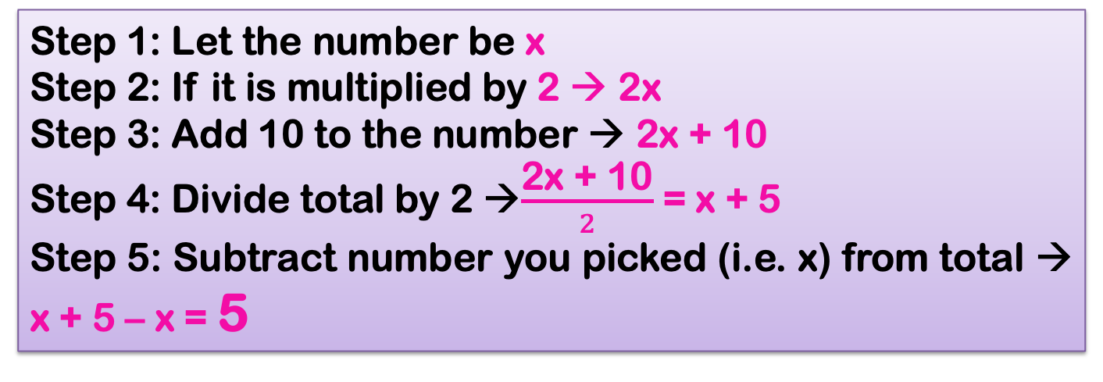
The Answer will be 5 !
Step 1: Let the number be x
Step 2: If it is multiplied by 2 → 2x
Step 3: Add 10 to the number → 2x + 10
Step 4: Divide total by 2 →$\frac{\text{2}\text{x}\text{ + 10}}{2}$ = x + 5
Step 5: Subtract number you picked (i.e. x) from total → x + 5 – x = 5

Slide 41

SUMMARY
The letters which are used to represent numbers are called Literal Numbers or Literals.
Literal numbers obey all the properties regarding the operation of addition, subtraction, multiplication or division.
Constant is a quantity which does not change its value.
Variable is a quantity which changes its value.
Notes:
Dunia tidak lagi stagnan. Cara belajar sudah berbeda. Teknologi mengubah segalanya. Berubah dan berinovasi menjadi kebutuhan mendesak.
Adanya kemendesakan untuk:
a. Pelatihan berpikir kritis, kreatif, kolaboratif
b. Keberanian untuk memasuki wilayah-wilayah baru
c. Kesediaan dan keterbukaan untuk beradaptasi.
Hal-hal tersebut akan menentukan apakah generasi berikut bisa bertahan hidup atau tidak.

Slide 42
SUMMARY
Algebraic Expression is a combination of numbers, literal numbers and fundamental questions.
Parts of an algebraic expression separated by the symbols (+) and (-) are called the terms.
Terms having same variables are called Like Terms and terms having different variables are called Unlike Terms.
For addition and subtraction of algebraic expression only like terms are to be added or subtracted in both horizontal and column method.
Notes:
Dunia tidak lagi stagnan. Cara belajar sudah berbeda. Teknologi mengubah segalanya. Berubah dan berinovasi menjadi kebutuhan mendesak.
Adanya kemendesakan untuk:
a. Pelatihan berpikir kritis, kreatif, kolaboratif
b. Keberanian untuk memasuki wilayah-wilayah baru
c. Kesediaan dan keterbukaan untuk beradaptasi.
Hal-hal tersebut akan menentukan apakah generasi berikut bisa bertahan hidup atau tidak.

Slide 43
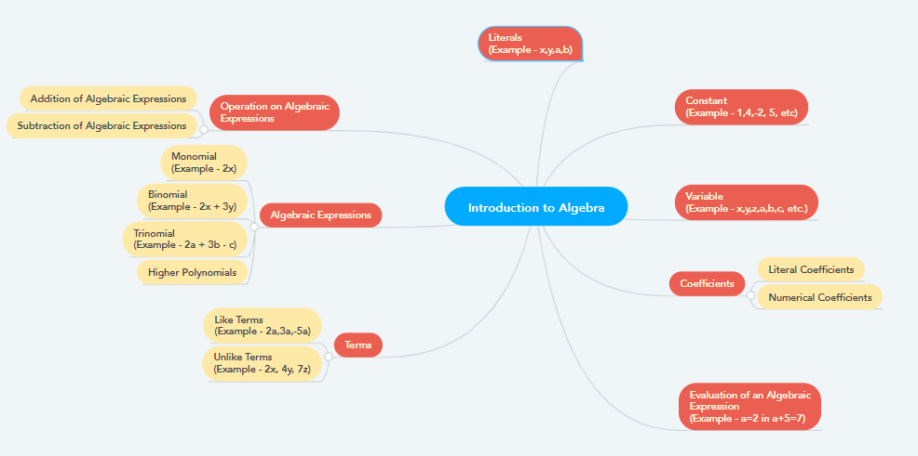
Mind Mapping Diagram

Slide 44





Thanks
for your attention

