Slide 1





Creative Writing
Meeting 11
Modified by Dr. Pratiwi Amelia, M.Pd
Pembelajaran Daring Kolaboratif 2023

Slide 2



:
Dr. Pratiwi Amelia, M.Pd.B.I
Lecturer of Universitas Muhammadiyah Bangka Belitung
NIDN : 0220068601
: +62 81227880960
: pratiwi.amelia@unmuhbabel.ac.id

Slide 3



Today’s topic
Highlight
Summarizing texts/articles
Creative writing is a type of writing in which ideas and thoughts are expressed in an innovative way. It includes fiction, poetry, playwriting, and nonfiction, among other genres and styles.
Summarizing opinions from news articles
Analyzing texts/articles
It is an art form that goes beyond ordinary writing, letting people to express themselves via the power of words.
Analyzing article opinions
Writing for News Media/Opinion

Slide 4
What is Summarizing?
When to write a summary?
There are many situations in which you might have to summarize an article or other source:
  As a stand-alone assignment to show you’ve understood the material
  To keep notes that will help you remember what you’ve read
  To give an overview of other authors’ work
Summarizing is defined as the process of extracting material from a lengthier chapter, theory, or write-up and condensing it into a smaller version that includes all of the original version's facts and important ideas. Summarization is the process of mechanically compressing and rewriting a huge piece of material in order to provide a short, concise summary.
Summarizing can be accomplished by writing a three to four phrase description that contains all of the important aspects of a story, news item, poem, etc.
Why do we summarize writing?
In order to be effective, they distill the text down to the most vital parts.

Slide 5


How to summarize the article?
Five key steps that can help you to write a summary:
  Read the text
  Break it down into sections
  Identify the key points in each section
  Write the summary
  Check the summary against the article
Some steps:
  Skim through the article to get a general sense of the content.
  Read the article carefully, focusing on the main ideas and supporting details.
  Highlight or underline key points that you want to include in your summary.
  Take notes on the main arguments and any relevant examples or evidence.
  Pay attention to the structure of the article, including the introduction, body, and conclusion.

Slide 6

Step 1: Read The Text
  Scan the article quickly to get a sense of its topic and overall shape.
  Read the article carefully, highlighting important points and taking notes as you read.
  Skim the article again to confirm you’ve understood the key points, and reread any particularly important or difficult passages.
Pay attention to headings and subheadings. These should give you a good sense of what each part is about.
Read the introduction and the conclusion together and compare them: What did the author set out to do, and what was the outcome?

Slide 7

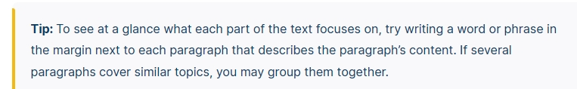
Step 2: Break the text down into sections
Try to make the text more manageable and understand its sub-points, break it down into smaller sections.

Slide 8

Step 3: Identify the key points in each section
  Pick out the most important points and try to extract the essential points.
  These main points are the core ideas or arguments that the article revolves around.
  Main points in a news article are the central ideas or arguments that the author wants to communicate to the readers.
  They are usually found in the introductory paragraphs or headings of the article.

Slide 9
Step 4: Write the Summary & Analysis of a Text
  Pick out the most important points and try to extract the essential points.
  Put all the essential elements of the text while eliminating any redundant or irrelevant information.
  Use paraphrasing. Paraphrasing requires that the student puts the article’s essence into their own words.
  Some useful transitional words and phrases to use in summaries include: Furthermore, therefore, however, n the contrary, in conclusion, etc
Some questions for students to focus on when writing their summary include:
  What is the title of the article?
  What is the article’s main topic?
  Who is the author?
  Who is the target audience?
  What is the tone of the article?
  What is the author’s purpose?

Slide 10
Let’s Practice!
King Mahala was fond of gold more than anything else in the world. He treasured his royal crown because it was made of that precious metal. If he loved anything good or half as good, it was a little girl who played around her father’s feet so happily. But the more Mahala loved his daughter, the more he desired wealth. He thought the foolish man that he was, the best thing he could possibly do for his beloved child was to bestow upon him the great pile of yellow shiny coins that had been collected since the creation of the world. So, he gave all his thoughts and all his time to this one cause. If ever he looked for a moment at the golden clouds of sunset, he wished they were gold and that they could be safely squeezed into his strong box.
https://englishluv.com/summary-writing-examples-with-answers/
(144 Words)
Chief Points:
(i) King Mahala was very fond of gold.
(ii) He loved gold for his daughter to whom he wanted to give all the gold in the world.
(iii) He even wished the gold-coloured clouds of the sunset to be true gold.

Slide 11
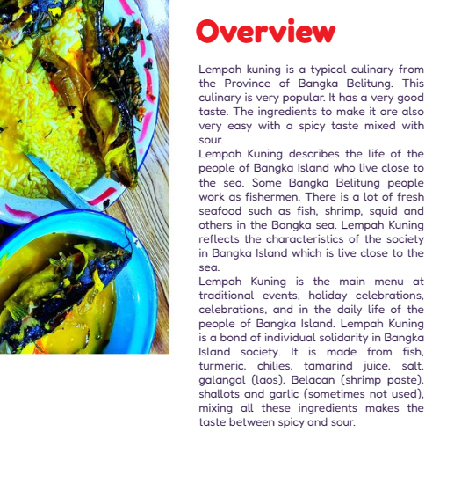
Let’s Practice and Make Summary!
Chief Points?
1.
2.
3.

Slide 12

Thank You

