Slide 1

Equal Employment Opportunity & Workforce Diversity
NAMA KELOMPOK : PULONG
: HANSEL
: THEO

Slide 2

Apa sih Equal Employment Opportunity (EEO) itu ???

Slide 3


Equal Employment Opportunity (EEO) dibedakan menjadi beberapa bagian yaitu :
equal employment Opportunity an Overview
Federal Laws affecting equal employment Opportunity
Equal Employment opportunity Employer Information Report

Slide 4
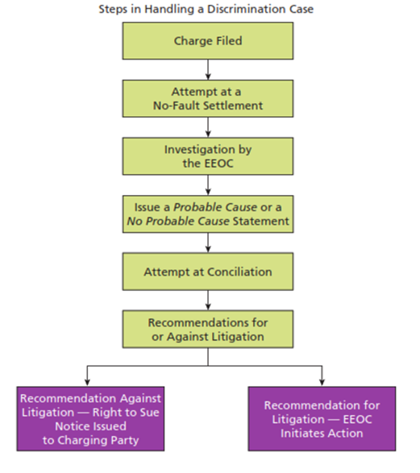
Who’s responsible for ensuring equal employment Opportunity?
Equal Employment Opportunity Commission
Office of Federal Contract Compliance Programs
Employers

Slide 5


Defining and Operationalizing illegal Discrimination
Uniform Guidelines on Employee Selection Procedures
Concept of Disparate Treatment
Concept of Adverse Impact

Slide 6


Slide 7
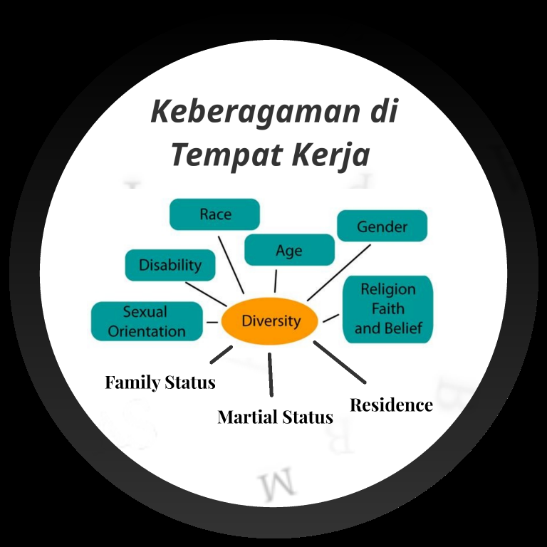

Slide 8


