Slide 1
Strategic & Human Resource Planning
Nicholas Chiesa
Jeremy Jonathan

Slide 2
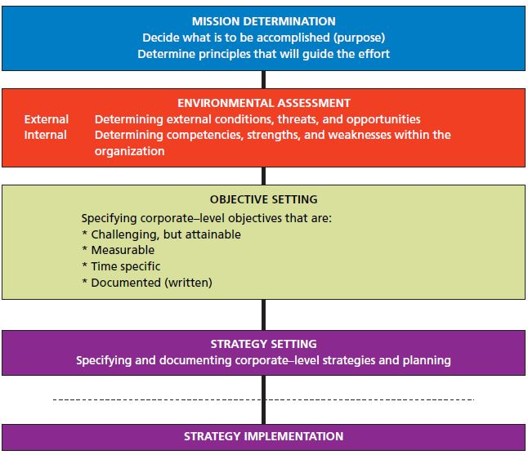
Strategic Planning Process

Slide 3


Mission Determination // Menentukan Misi
Langkah awal yaitu menentukan misi suatu perusahaan, menentukan tujuan dan alasan keberlangsungan suatu perusahaan
& Determine principles that will guide the effort // Tentukan prinsip yang akan memandu usaha anda .
Key :
&Decide what is to be accomplished (purpose) // Putuskan apa yang ingin dicapai (tujuan) atau GOALS.
Other
Goals

Slide 4
Environmental Assessment // Penilaian Lingkungan
Setelah misi ditentukan, perusahaan harus menilai kekuatan dan kelemahannya di lingkungan internal dan ancaman serta peluang dari lingkungan eksternal atau Analisis SWOT
Strategi ini akan memanfaatkan kekuatan perusahaan dan meminimalisir kelemahan untuk menangkap peluang dan menghindari ancaman.

Slide 5
Objective setting // Mengatur tujuan
Objective atau tujuan merupakan hasil akhir yang diinginkan dari setiap aktivitas dalam perusahaan.
4 basic characteristics :
& They should be expressed in writing // Diungkapkan secara tertulis
& They should be measurable // Dapat diukur
& They should be specific as to time // Spesifik
& They should be challenging but attainable // Menantang tetapi harus bisa dicapai

Slide 6
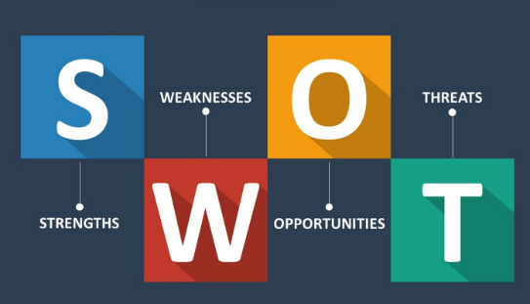

Strategy Setting// Pengaturan strategi
Setelah analisis swot tadi dilakukan lalu tahap selanjutnya yang lebih spesifik lagi yaitu mengatur strategi dengan cara mengembangkan atau memanfaatkan kekuatan perusahaan dan meminimalkan kelemahannya untuk menangkap peluang dan hindari ancaman

Slide 7
Strategy Implementation// Implementasi Strategy
Implementasi Strategi merupakan wujud pelaksanaan dari perancangan strategi yang telah dibuat lalu diimplementasikan Strategynya yang telah dibuat ke dalam perusahaan.
who has to implement strategy? // Siapa ?
Setiap orang yang ada didalam organisasi perusahaan tersebut atau setiap orang yang ada pada struktur organisasi seperti, Manajer, Leader, HRD dan para staff lainnya.

Slide 8
Human resources planing
The systematic process of matching the internal and external supply of people with job openings anticipated in the organization over a specific period of time.

Slide 9
Workforce planning has evolved from a knee-jerk planning undertaking to a fundamental strategic function. It includes
& Business plan
& HR data
& Statistical analyses of those data

Slide 10
& It is also incorporated into the business and financial planning process, so it provides a foundation for a plan that is aligned with the business strategy.

Slide 11
HR planning has two components
Requirements (Determining the number, skill, and location of employees the organization will need at future dates to meet its goals.)
and availability (Determination of whether the firm will be able to secure employees with the necessary skills, and from what sources.)

Slide 12
Forecasting human resource requirements
Before HR requirements can be projected, demand for the firm’s goods or services must be forecasted. This forecast is then converted into people requirements for the activities necessary to meet this demand.

Slide 13
Several techniques for forecasting HR requirements are currently used
qualitative in nature
and others are quantitative

Slide 14
Zero-base forecast
zero-base forecast Forecasting method that uses the organization’s current level of employment as the starting point for determining future staffing needs.

Slide 15
bottom-up forecast
Forecasting method in which each successive level in the organization, starting with the lowest, forecasts its requirements, ultimately providing an aggregate forecast of employees needed.

Slide 16
Relationship between Volume of Sales and Number of Workers Required
managers can approximate the number of employees required at different demand levels. Quantitative methods such as regression analysis can be helpful in determining the number of workers needed.

Slide 17
To forecast availability, the HR manager looks to both internal sources (current employees) and external sources (the labor market)

Slide 18
Shortage or surplus of Workers Forecasted
When firms are faced with a shortage of workers, organizations will have to intensify their efforts to recruit the necessary people to meet the needs of the firm.

Slide 19
Innovative Recruiting
In using innovative recruiting, businesses must attempt to determine who their prospective employees are and what motivates them

Slide 20
Compensation Incentives Firms
Firms competing for workers in a high-demand situation may have to rely on compensation incentives. Premium pay is one obvious method

Slide 21
Alternatives to Layoffs
Most companies look to alternatives to layoffs but downsizing may ultimately be required. At times, layoffs can be a necessary cost-cutting measure.
One of the first alternatives to layoffs is to implement a restricted hiring policy that reduces the workforce by not replacing employees who leave.

Slide 22
There are basically three forms of freezes
A hard freeze
A soft freeze
Smart freeze

Slide 23
Early retirement is another way to reduce the number of workers.
Another alternative to layoffs is permitting an employee to go from full-time to 30 hours a week without losing health benefits

Slide 24
Ask Your Questions
Q&A

Slide 25
Thank You For Your Attention

