Slide 1





COMPLEX AND COMPOUND
SENTENCE
Ika Suciwati, M.TESOL.
Amy Krisdina, M.Pd.

Slide 2



recap
  what did you learn last week?
  What are the components of complex and compound sentences?

Slide 3


complex
compound

Slide 4

Watch the video on spada again
  What subordinating conjunctions that you remember from the video?
  What are the types of subordinating conjunction based on the video?

Slide 5
presentation
Discuss the following text with your froup and identify its complex and compound sentences!

Slide 6
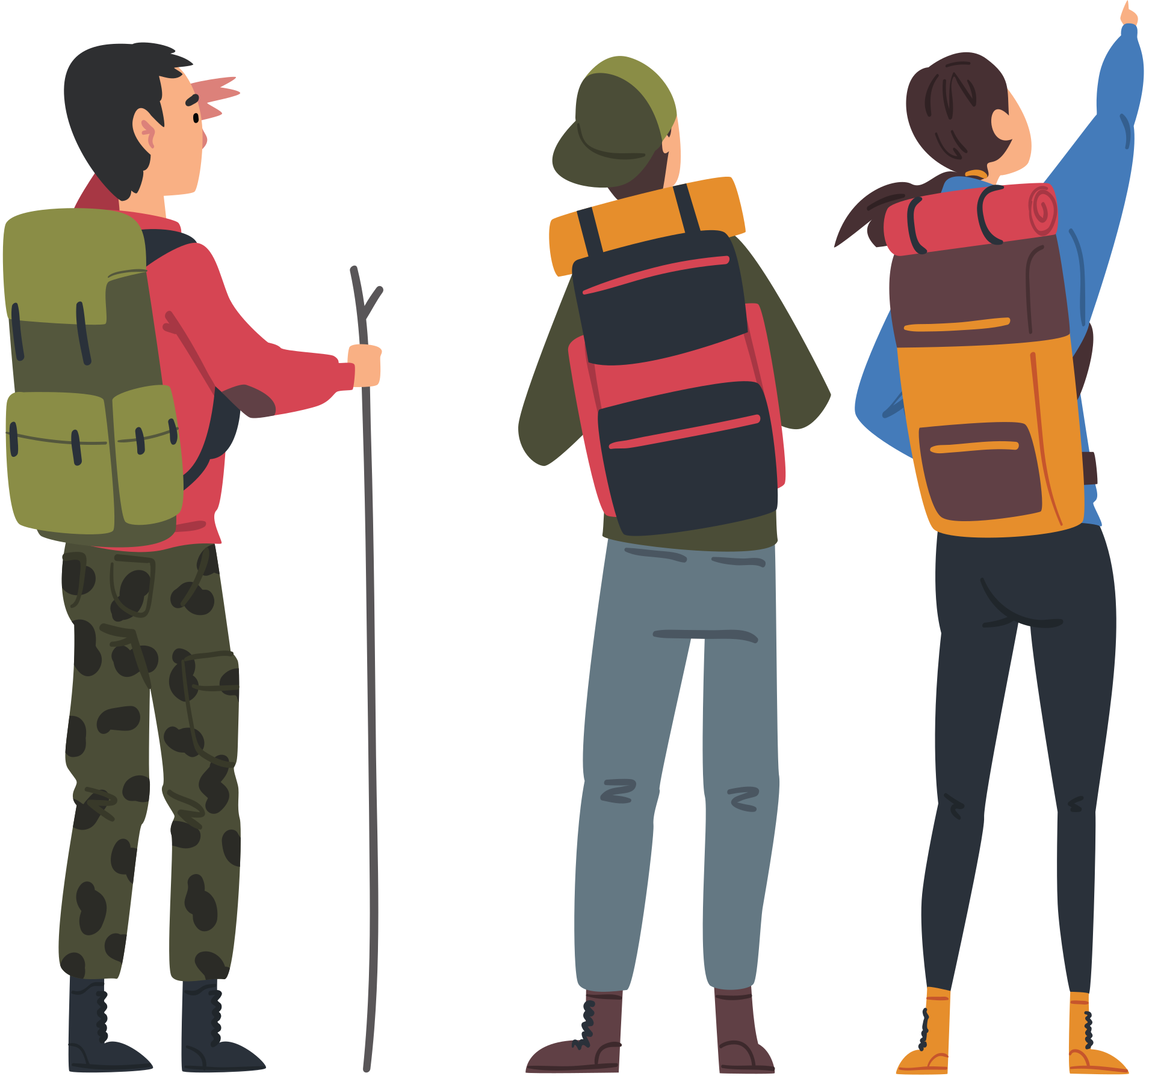
"The Mountain Adventure"
Last summer, my friends and I decided to go on a mountain hiking trip, and we were all excited about the adventure ahead. Although none of us were experienced hikers, we prepared by reading guides and packing essential gear. The trail was challenging, but we enjoyed every moment because the scenery was breathtaking, with tall trees and clear streams along the way. When we finally reached the summit, we felt an overwhelming sense of accomplishment, which made the difficult journey worthwhile. After resting and taking photos, we began our descent carefully, for we knew the path down could be even more dangerous.

Slide 7
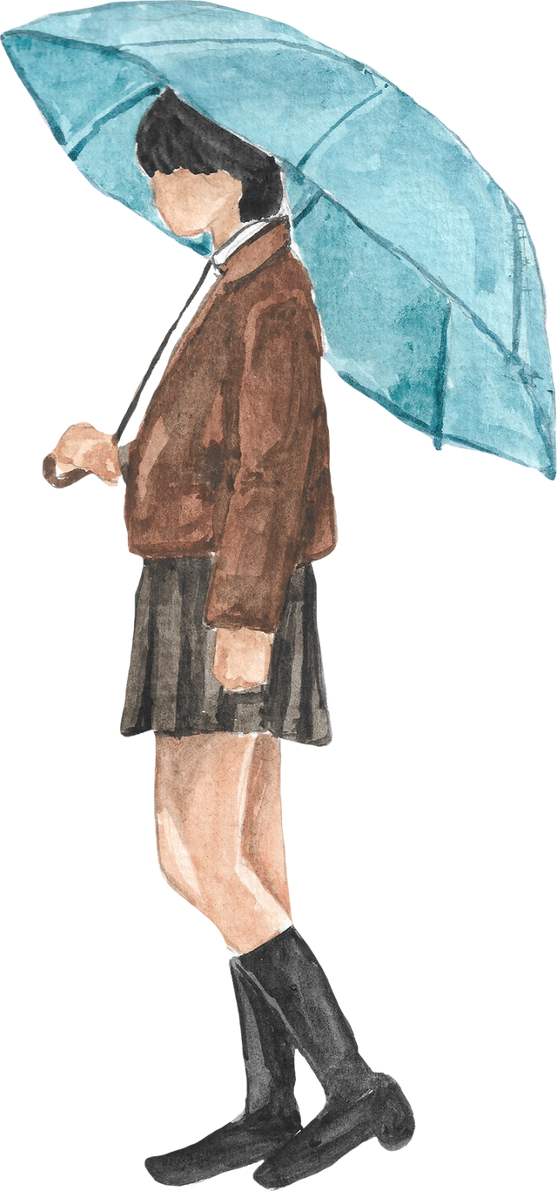
"A Rainy Day Surprise"
Yesterday, it rained heavily all morning, so I decided to stay indoors and catch up on some reading. Just as I settled down with a good book, my friend Sarah called, and she invited me over to bake cookies together. Although the weather was gloomy, I couldn’t resist the idea of freshly baked cookies, so I grabbed my umbrella and went to her house. We spent the afternoon baking and chatting, which made the rainy day feel warm and cheerful. By the time I got home, the rain had stopped, and a beautiful rainbow stretched across the sky.

Slide 8
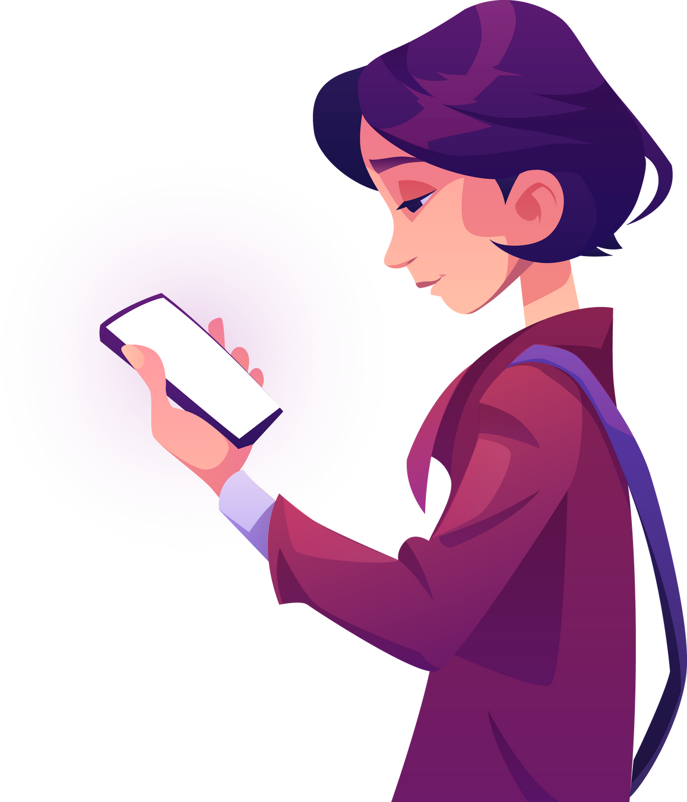
"The Lost Phone Adventure"
Last weekend, I went to the park to meet my friends, but I accidentally left my phone on a bench when we decided to go play soccer. After about an hour, I realized my phone was missing, which sent me into a bit of a panic. Although I was worried, I retraced my steps and hoped that someone honest had found it. Luckily, a kind stranger noticed it on the bench and handed it to the park attendant, who kept it safe for me. When I finally got my phone back, I was so relieved, and I thanked the stranger and the park attendant for their help.

Slide 9
presentation

Slide 10

reflection
What three things did you learn today?

Slide 11
THANK YOU :)

