Slide 1
EXPERT SYSTEM
Muchamad Kurniawan
Pertemuan ke-6

Slide 2
Expert System
(Tree rule)
Muchamad Kurniawan

Slide 3
Point of Views
Create structure Node
Create Rule
Create Diagnosys System
Testing in Main Program

Slide 4
Create Rule

Slide 6
Create Code

Slide 7
Create Tree with Struct

Slide 9
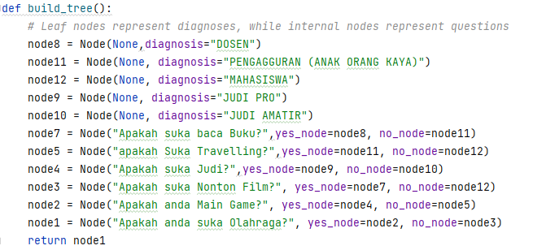

Slide 10
Create Diagnosis System

Slide 11
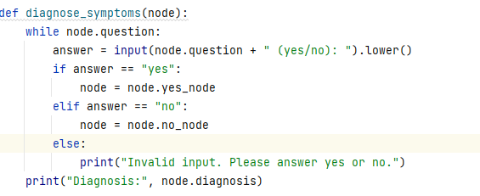

Slide 12
Create Diagnosis System

Slide 13
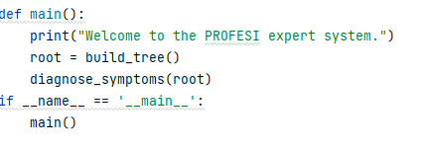

Slide 14
Testing

Slide 15
